Slide 1
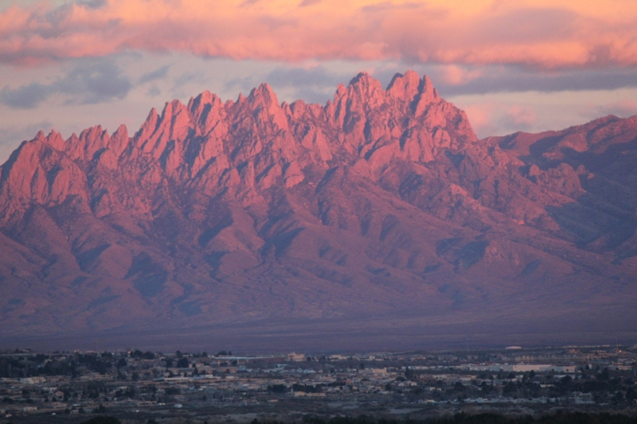
Southern New Mexico Ozone Modeling Study
Task 12: Ozone Source Apportionment Modeling
Ramboll-Environ (RE)
University of North Carolina (UNC-IE)
September 8, 2016

Slide 2
SNMOS Background and Objectives
The southern Doña Ana County region has the highest ozone levels of any area in New Mexico
The southern Doña Ana County area is within 95% of the federal standard for ozone
The New Mexico Air Quality Control Act requires the New Mexico Environment Department to develop a plan for reducing ozone levels in areas that are within 95% of the ozone standard
The first step towards developing the plan is to understand the causes of high ozone in Doña Ana County
SNMOS objectives:
Study the factors contributing to high ozone in Doña Ana County
Investigate future emissions scenarios that will produce attainment of the ozone standard

Slide 3
Overview of Approach
SNMOS builds off of the Western Air Quality Study (WAQS)
WAQS 2011 modeling platform: WRF/SMOKE/CAMx
Adjustments to the meteorology and modeling domains to optimize for southern New Mexico
Modeling 2011 New Mexico ozone season: May 1 – August 31
Modeling Plan
Prepare base year emission inventories
Run WRF/SMOKE/CAMx for 2011 base year
Evaluate 2011 base year model against observations, refine model if needed
Prepare future year emission inventories for 2025
Run SMOKE/CAMx for future year
Modeled Attainment Test
Emissions sensitivity/control runs
Source apportionment to diagnose causes of high ozone in Doña Ana County
Reporting

Slide 4
SNMOS Tasks
Completed
Task 1: 2011 WRF 36/12/4 km with 4 km focus on Dona Ana/El Paso/Juarez and Work Plan (11/30/15)
Task 2: 2011 update Permian Basin O&G (11/30/15)
Task 3: 2011 update of Juarez and nearby Mexico EI, 2020 Mexico emissions update (11/30/15)
Task 4: SMOKE current 2011 NEI for 4 km domain (2/29/16)
Task 5: Gridded 2011 biogenic, fires, wind-blown dust, lightning emissions for 4 km domain (2/29/16)
Task 6: Develop 2011 4 km CAMx database and perform base case (2/29/16)
Task 7: 2011 MPE and sensitivity modeling for Dona Ana County (4/30/16)
Task 8: SMOKE current FY US EI and FY Mexico emissions update (4/30/16)
Task 9: FY 12/4-km CAMx simulation (5/31/16)
Task 10: FY ozone projections (MATS) (5/31/16)
Task 11: 2025 emissions sensitivity/controls (8/15/16)
This Deliverable Period (9/15/2016)
Task 12: Ozone source apportionment modeling of 2011 and 2025
Pending
Task 13: Air Quality Technical Support Document (AQTSD)

Slide 5
Task 12: Objectives and Deliverables
Objective
Carry out SNMOS ozone source apportionment CAMx modeling of 2011 and 2025 (Completed July 18, 2016)
Deliverables
PowerPoint presentation on ozone source apportionment modeling (Completed September 8, 2016)
Tasks
Run CAMx 12/4 km using ozone source apportionment for 2011 and 2025
Use EPA’s MATS to calculate design values for both years
Determine the source regions and source categories that contribute to elevated ozone concentrations in Doña Ana County and vicinity
Obtain the contributions of Mexico emissions to 2011 ozone Design Values (DVs)
Calculate 2025 ozone DVs without the contributions of fire emissions
Prepare PowerPoint Presentation (this document)
Provide interactive spreadsheet source apportionment results on ozone DVs
Provide SA Visualization Tool for 2011 and 2025 ozone contributions to MDA8 ozone at monitors (hosted on IWDW and available through wiki)

Slide 6
CAMx Air Quality Modeling
CAMx configured as in SNMOS Base11b
See SNMOS Task 7 MPE report
CAMx run for April–August, 2011 and 2025
2011 dates for 2025 run
Emissions
Primarily from EPA NEI2011 v6.2 modeling platform 2025 projection
2020 WAQS oil and gas projections
Biogenic, lightning, fires, and sea salt constant at 2011 levels
SNMOS Task 3 deliverable for Mexico future year EI details
SNMOS Task 8 deliverable for US future year EI details
CAMx OSAT tool used for source apportionment modeling of 2011 and 2025
Presenting results from 4 km grid

Slide 7
MATS Configuration
DVF calculation uses maximum concentration from a matrix of modeled grid cells surrounding a monitor
Current EPA guidance followed here: 3x3 matrix (9 cells)
RRF calculation
Used top 10 modeled days
70 ppb threshold
Minimum number of days at or above threshold: 1 day
To calculate contribution of each source group
Ran MATS with full CAMx output
Subtracted ozone contribution from source group X from full model output
Reran MATS without contribution from X
Difference of two MATS runs is contribution from X to the DV
Slides 51 and 52 have calculation details

Slide 8
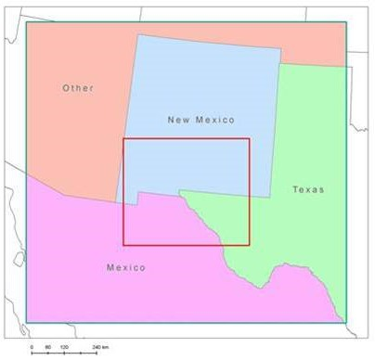
Source Groups
4 source regions
(1) New Mexico; (2) Texas; (3) Mexico; and (4) Arizona with remainder of other states in the 12 km domain
8 emissions source categories
Natural (biogenics and lighting NOx)
On-Road Mobile
Non-Road Mobile
Oil and Gas (point and non-point)
Electrical Generating Unit (EGU) Point
Non-EGU Point
Open Land Fires (wildfire, prescribed, and agricultural burning)
Remainder Anthropogenic (mainly area)
Initial and boundary conditions
34 total Source Groups (34 = 4 x 8 + 2)

Slide 9
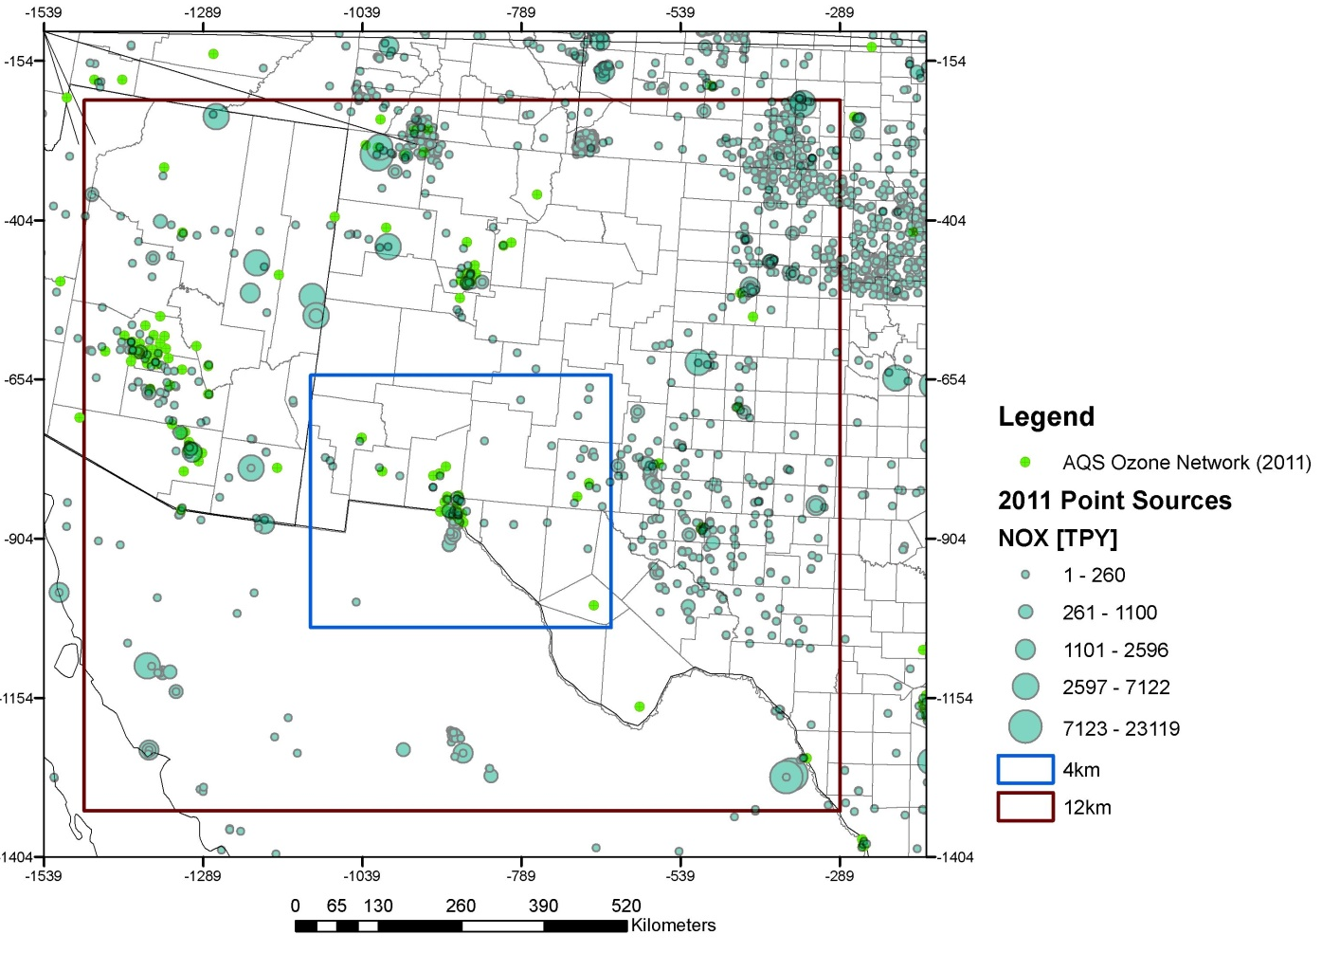
Boundary Conditions (BCs)
BCs represent transport from outside of the 12/4 km SNMOS domain:
Transport from sources in remainder of U.S.
International transport
Natural global ozone background including stratospheric intrusions
Includes more than just U.S. background (USB) or North American background (NAB)

Slide 10
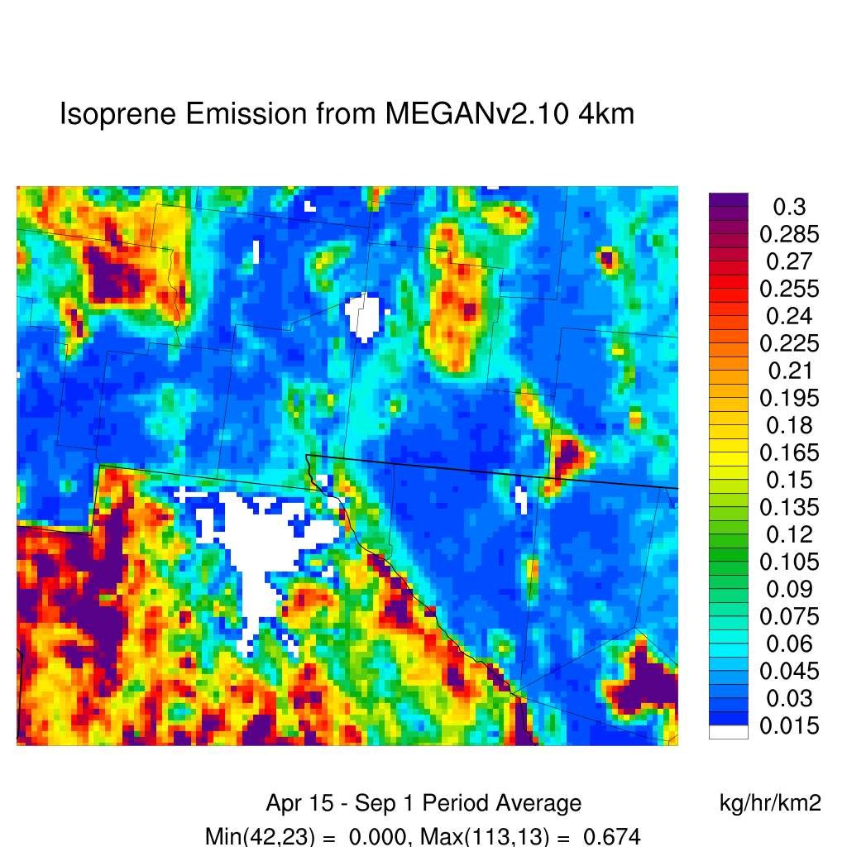
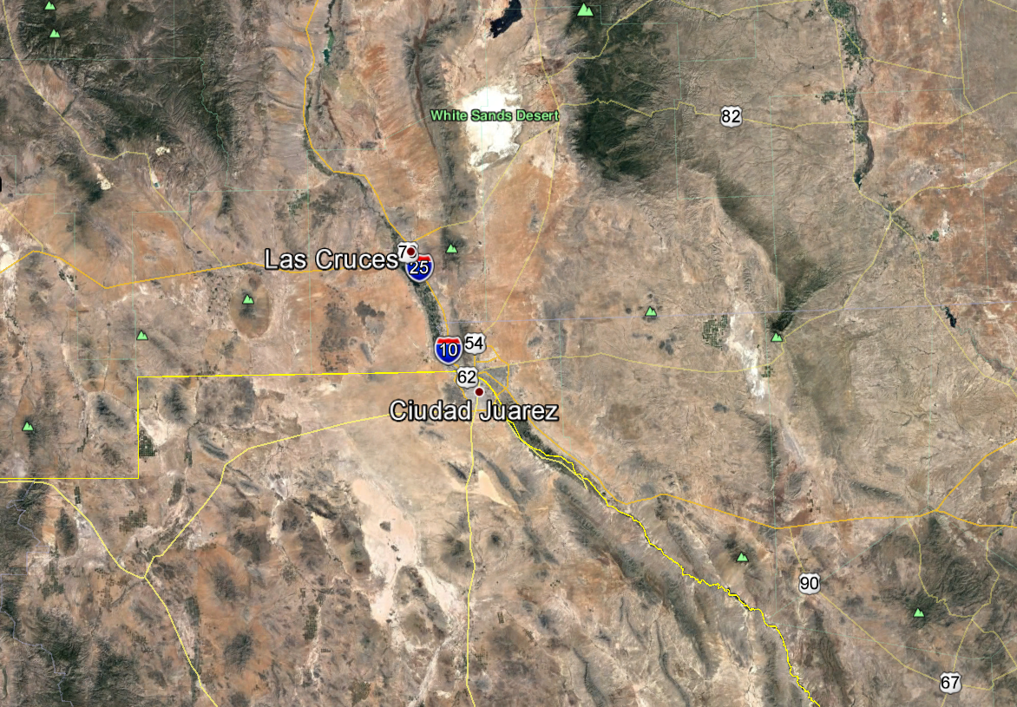
Natural Emissions: Biogenic Isoprene Emissions: 4 km Grid
MEGAN v2.10 Episode Average Isoprene
Emissions on 4 km Grid
Google Earth Imagery
Of 4 km Domain Region
Large contribution from Mexico natural emissions
Discontinuity at US-Mexico border (white arrow) suggests uncertainty in biogenic emission inventory

Slide 11
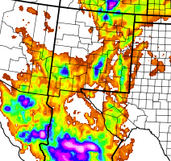
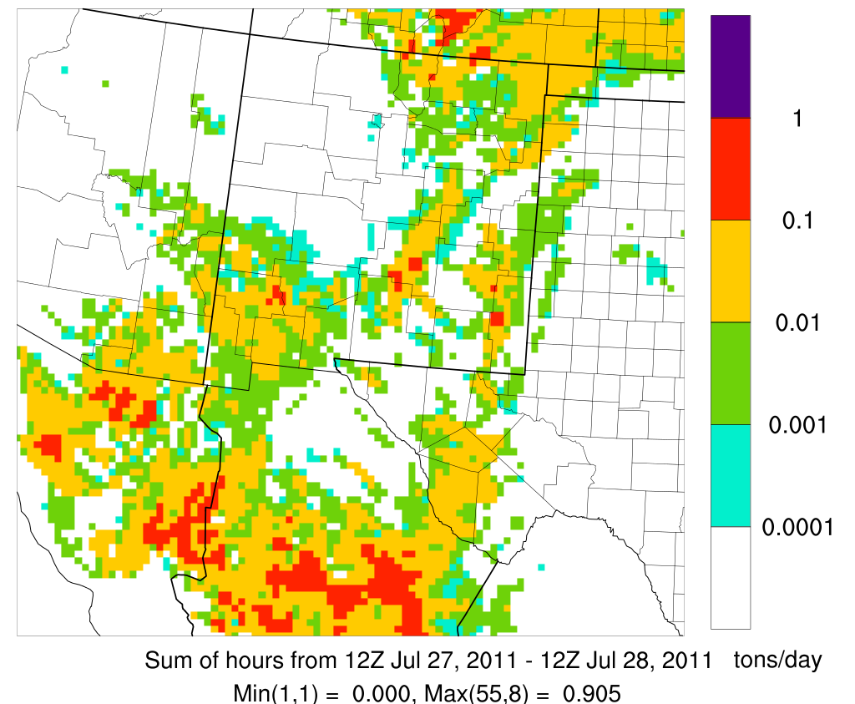
Natural Emissions: Lightning NOx July 27-28, 2011
WRF MSKF NAM Run Precipitation
Column-Integrated LNOx Emissions
LNOx emissions are uncertain and may affect the contribution from Mexico natural emissions

Slide 12
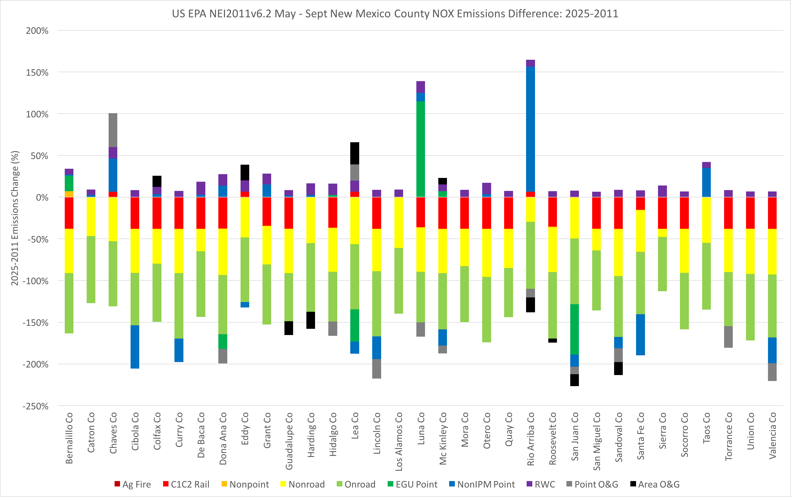
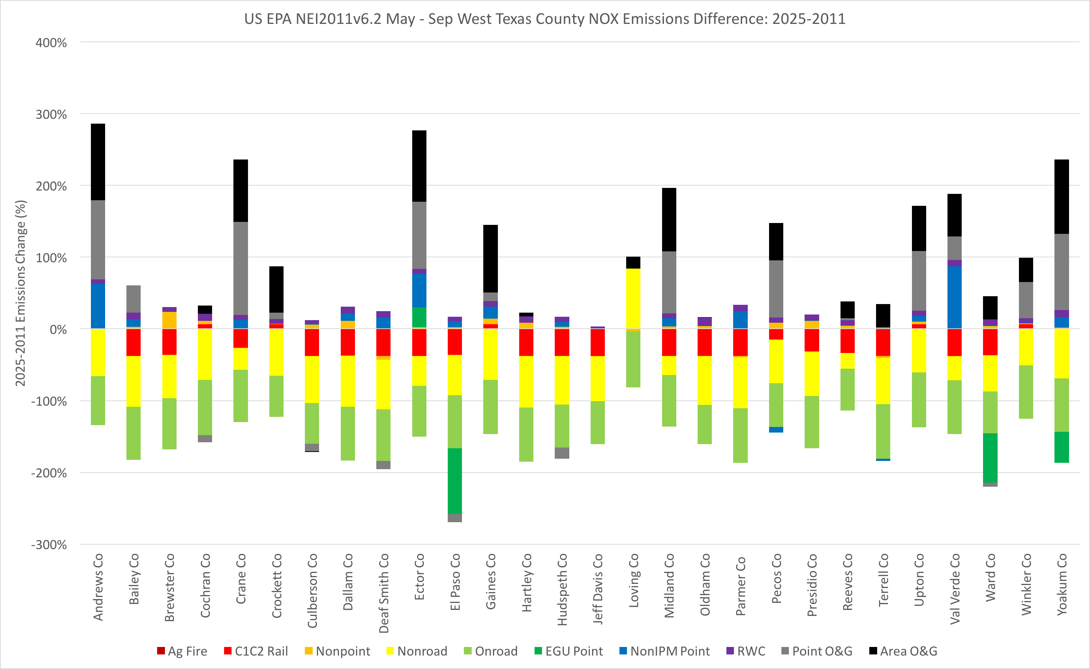
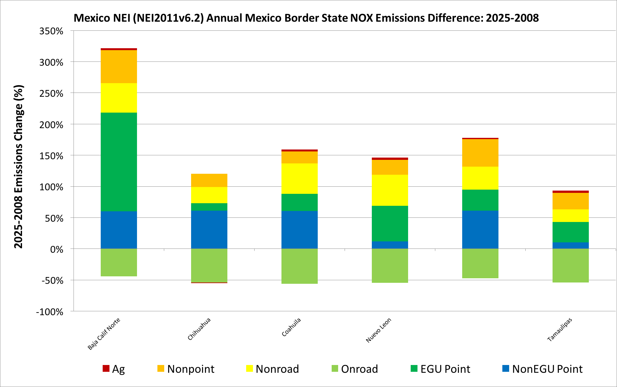
SNMOS 2025 Emissions Modeling
Dona Ana
Decreases in onroad and offroad mobile NOx emissions
Mexico
Decreases in onroad mobile NOx
Increases in EGU and non-EGU point NOx emissions
West Texas
Decreases in onroad and offroad mobile
Increases in O&G
Percent Difference ([2025-2011]/2011)
New Mexico
W. Texas
Mexico
Sonora
Notes:
Reductions in onroad mobile in all regions, reductions in offroad in US, increases in EGU and non-EGU point emissions in Mexico, increases in O&G emissions in TX and NM

Slide 13
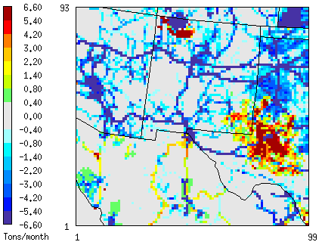
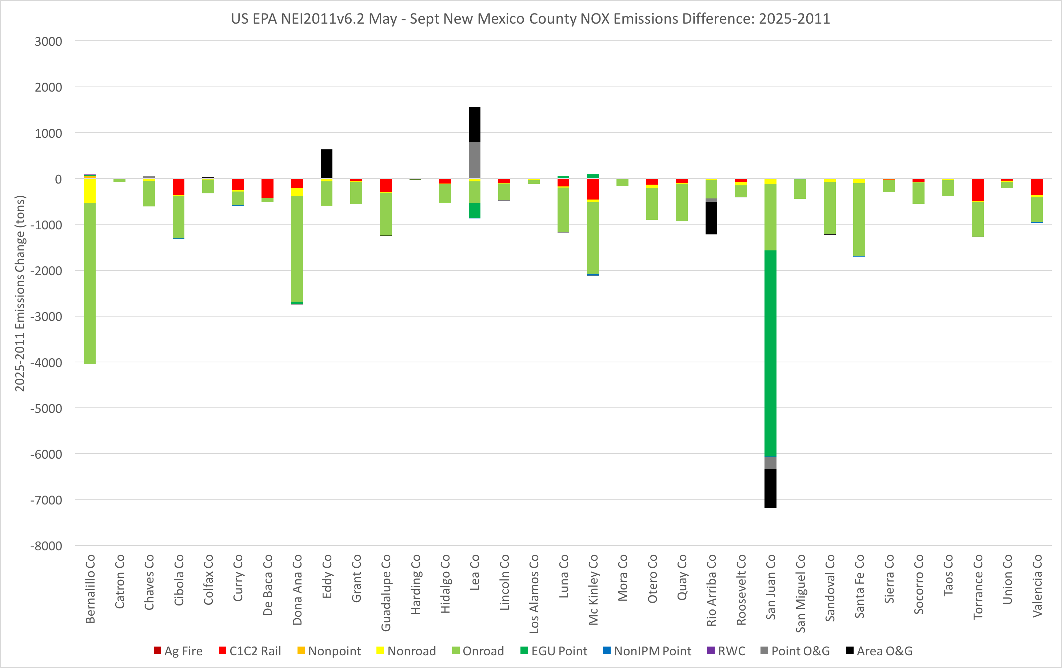
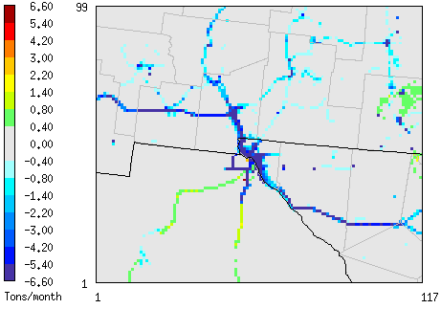
SNMOS 2025 Emissions Modeling New Mexico 2011 and 2025 NOx Emissions Differences
2025-2011 NOx Emissions
Absolute Difference (2025-2011)

Slide 14
Which Source Groups Contribute to Doña Ana County Ozone?
How important is transport in determining ozone at Doña Ana monitors?
Boundary conditions, transport within 12/4 km domain
What emissions source categories contribute at Doña Ana monitors?
Top contributing source groups at each monitor
Contribution of New Mexico anthropogenic emissions
Evaluate consistency of OSAT results with UNC 2011/2025 emissions plots
Detailed results for Desert View and Santa Teresa monitors
Results for other monitors follow End slide

Slide 15
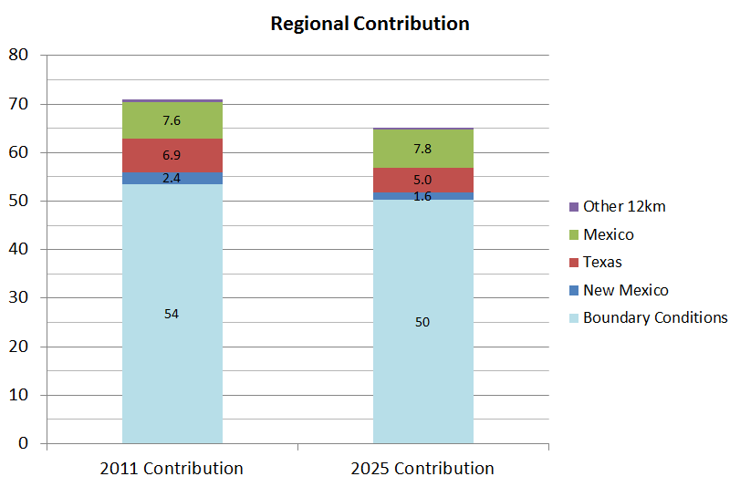
Role of Transport Ozone DV at Desert View Monitor
12 km BC contribution to DVs is far larger than those of regions within the 12 km domain
BCs contain effect of
Sources within the US (e.g. Los Angeles and Phoenix)
Sources outside the US (Asia, regions of Mexico outside the 12/4 km grid)
Stratosphere contribution
Similar results for other Doña Ana monitors
Transport
NM
Contribution to DV (ppb)

Slide 16
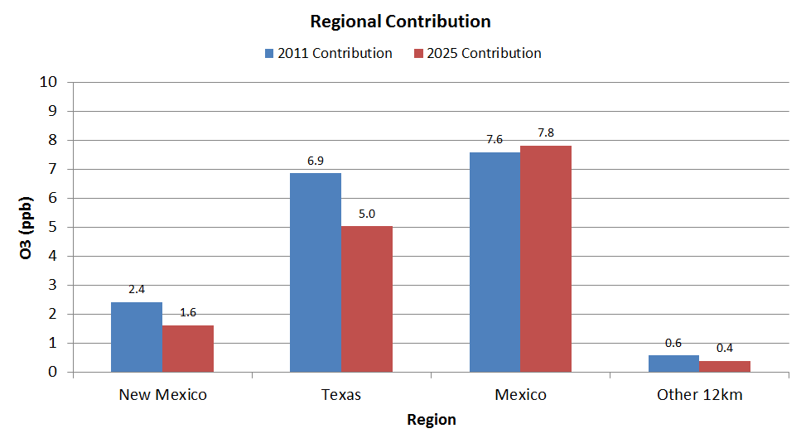
Desert View DVC: 71.0 ppb DVF: 65.1 ppb
NM contribution smaller than Texas and Mexico contributions
Reduction in 2025 DV driven by decrease in BCs and in contributions from New Mexico, Texas and Other 12 km
Contribution from Mexico increases slightly

Slide 17
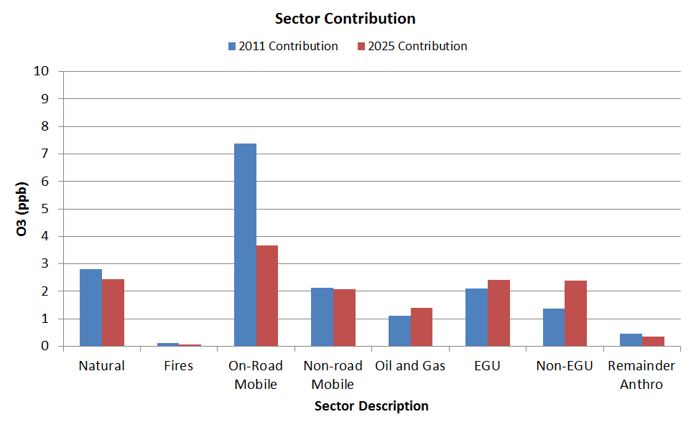
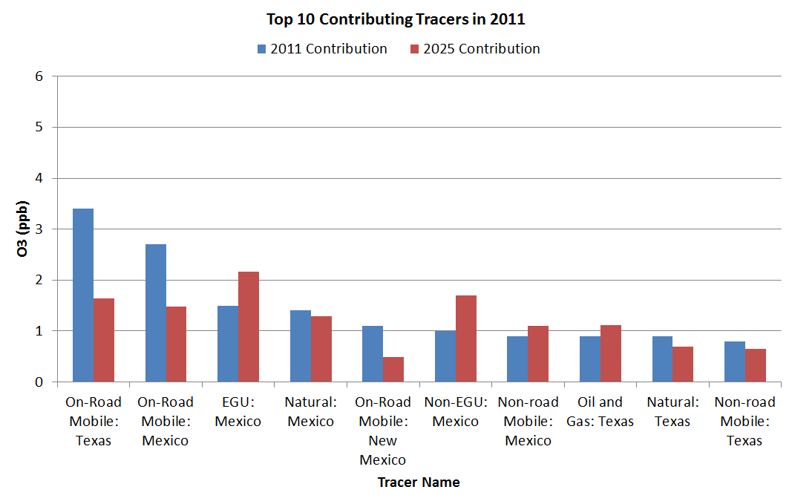
Desert View DVC: 71.0 ppb DVF: 65.1 ppb
Reductions in Texas, New Mexico and Mexico on-road contributions are responsible for much of ozone decrease in Desert View DV in 2025
Largest 2011 contributions to Desert View DV are from Texas and Mexico on-road and Mexico EGU and natural emissions
Largest 2025 contributions are from Mexico EGU and non-EGU point sources and on-road emissions from Texas and Mexico

Slide 18
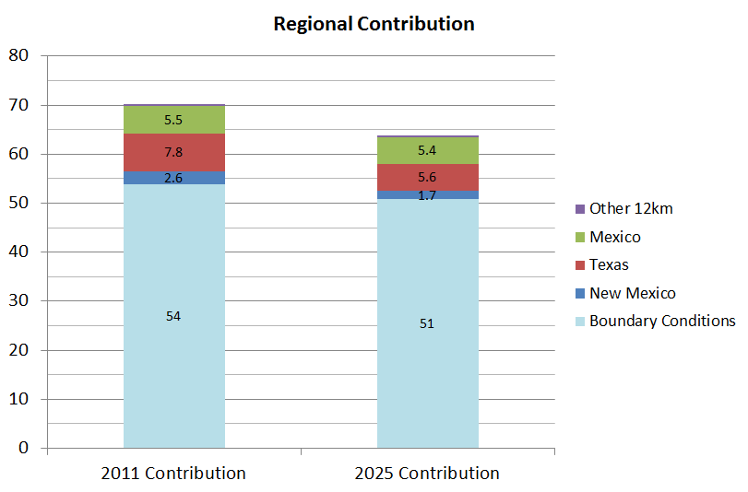
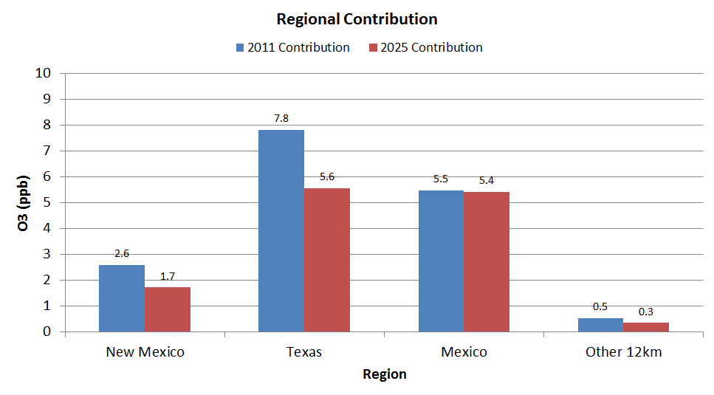
Santa Teresa DVC: 70.3 ppb DVF: 63.8 ppb
Reduction in DV driven by reductions in BCs and contributions from Texas and New Mexico
Contribution from Other 12 km declines
Slight decrease in Mexico contribution

Slide 19
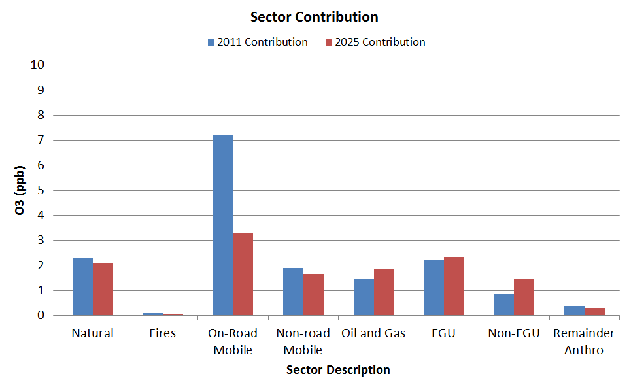
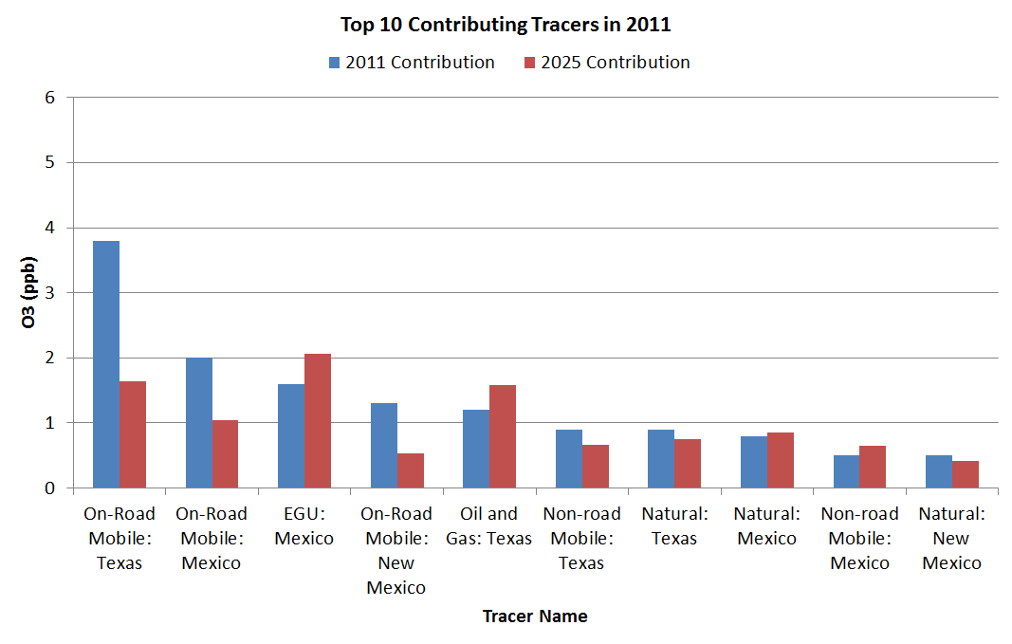
Santa Teresa DVC: 70.3 ppb DVF: 63.8 ppb
Large reduction in onroad mobile contribution in 2025
Increases in Mexico EGU and Texas oil and gas contributions in 2025
Largest 2011 contributions from Texas, New Mexico and Mexico on-road emissions and Mexico EGUs

Slide 20
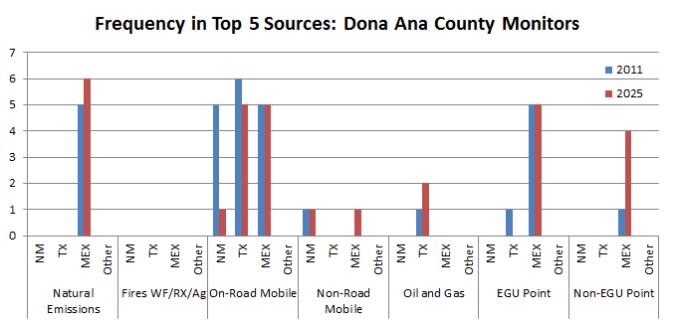
Most Frequent Top 5 Contributors to the DVs of the 6 Doña Ana Monitors
# of Times Source Group Appears in
List of Top 5 Contributing Sources
Source Group
On-road, natural (Mexico) and EGU emissions appear most frequently in the list of top 5 contributors to Doña Ana County monitor DVs
All 6 Doña Ana County monitors have TX onroad mobile sources in top 5 in 2011
Mexico is the most frequently appearing source region
Notes:
Picked top 5 source groups because after 5 source groups, 2011 ozone contribution was often < 1 ppb
Green arrow to call out reduction in frequency of appearance of NM onroad mobile from 2011 to 2025

Slide 21
Monitors in the 4 km Domain
Hurley
No Data
Solano
No Data
Carlsbad
Deming
Chaparral
La Union
Desert View
Skyline Park
Santa Teresa
Ivanhoe
Sunland Park
Socorro Hueco
UTEP
Ascarate Park
Chamizal

Slide 22
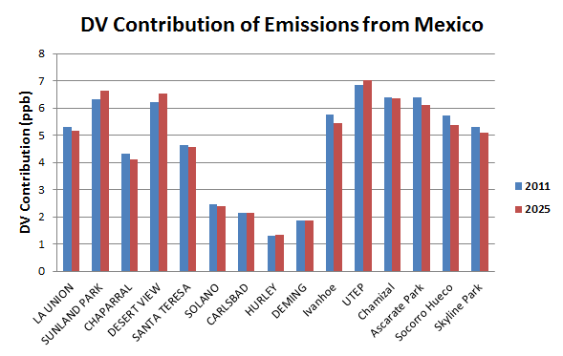
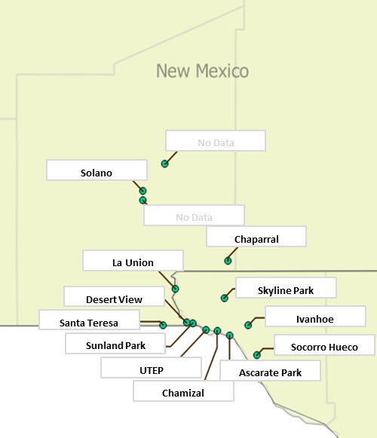
Contribution of Anthropogenic Emissions from Mexico to DVs for Monitors in 4 km Grid
Doña Ana
Contributions to DV from Mexico anthropogenic emissions range from ~2-6 ppb at Doña Ana monitors and are similar in 2011 and 2025
Monitors in NM near US-Mexico border and El Paso monitors have larger contributions from Mexico anthropogenic emissions

Slide 23
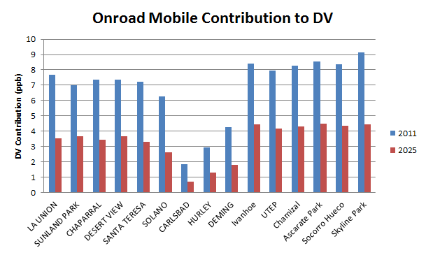
Contribution of Onroad Mobile Emissions to DVs for Monitors in 4 km Grid
Large 2011 contributions from on-road emissions to DVs at Doña Ana and El Paso monitors
Large decreases in onroad mobile contribution in 2025 for all sites

Slide 24
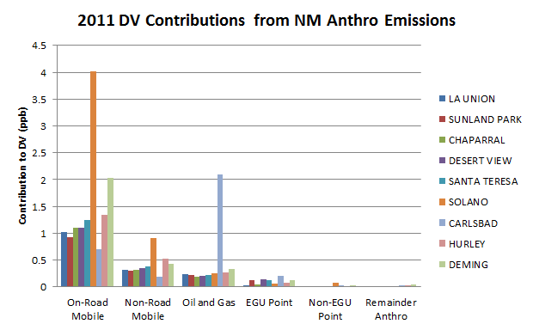
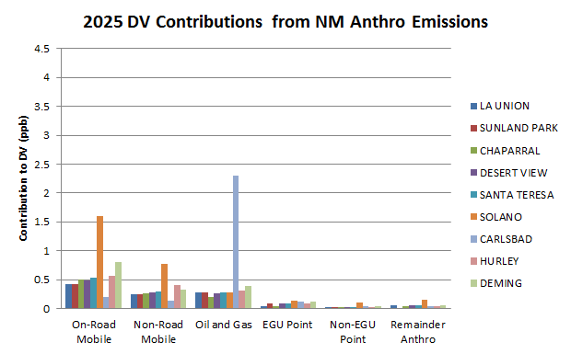
Contribution of NM Anthropogenic Emissions to 4 km Grid NM Monitor DVs
Onroad mobile emissions make largest NM anthropogenic contribution to DV at most NM monitors
Solano monitor has largest contribution from onroad mobile
Decreases in 2025
Nonroad and O&G make next largest contributions, followed by EGU points
Oil and gas dominates at Carlsbad
Influence of Permian Basin
Impact increases in 2025 consistent with projected growth in emissions

Slide 25
Which Source Groups Contribute to Doña Ana County Ozone?
Boundary conditions are by far the largest contributor
Typical result for a regional modeling grid
NM contribution smaller than either TX and MEX contribution to DVs for all Doña Ana monitors except Solano
Solano has a large onroad mobile contribution
In 2011, emissions source categories contributing most to DVs were onroad mobile (TX, NM, MEX), natural emissions (MEX) and EGUs (MEX)
Onroad mobile contribution is smaller in 2025

Slide 26
Contribution of Emissions from Mexico to Doña Ana County Ozone
Assess contribution of Mexico emissions to DVs at Dona Ana monitors in 2011 and 2025
Compare with results of Task 11 Sensitivity Testing
Section 179B “But for” test

Slide 27
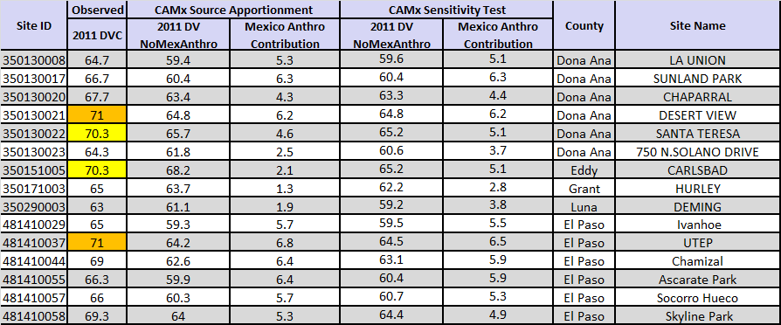
Ozone Contribution to 2011 DVs from Mexico Anthropogenic Emissions
But for the contribution of emissions from Mexico, the Desert View monitor would have attained the 70 ppb NAAQS in 2011
Monitors closer to US-Mexico border have larger Mexico contribution (e.g. El Paso monitors)

Slide 28
Comparison of Sensitivity Test and Source Apportionment Results
Contribution of Mexico Emissions to 2011 DVs for Doña Ana County Monitors (4 km Grid Results)
Results are comparable in magnitude and are consistent in showing that Mexico emissions had a significant impact on Doña Ana County DV in 2011
Source apportionment results show similar maximum and average impacts than sensitivity test and lower minimum impact

Slide 29
Contribution of Emissions from Mexico to Doña Ana County Ozone: Summary
But for the contribution of emissions from Mexico, the Desert View monitor would have attained the 70 ppb NAAQS in 2011
Also true for UTEP monitor in El Paso
Mexico SA contribution to Doña Ana monitor 2011 DVs ranges from 2.5 – 6.3 ppb with average of 4.9 ppb
Monitors closer to US-Mexico border have larger Mexico contribution (e.g. El Paso monitors)
Results of sensitivity test (Task 11) and source apportionment modeling (Task 12) are consistent

Slide 30
Contribution of Fire Emissions to Doña Ana County Ozone
CAMx modeling of 2011 showed large impacts from fire emissions
Active fire season during 2011 with large fires within 12 km domain
Treated fires separately from the rest of the natural emission inventory so their impacts could be tracked
Used source apportionment to quantify effect of fire emissions on Doña Ana DVs

Slide 31
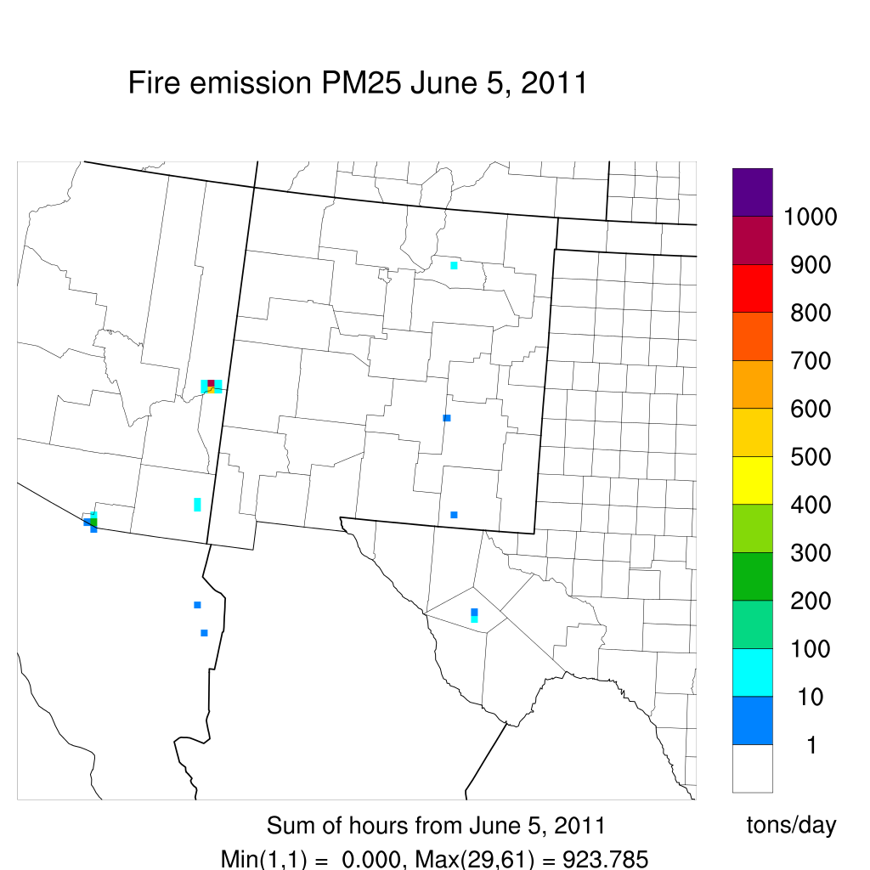
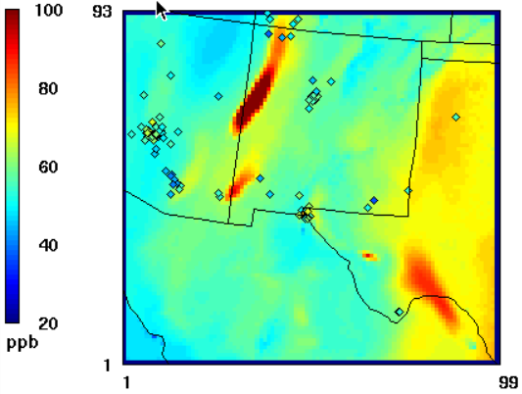
Fire Ozone Impact Example
PMDETAIL PM_{2.5} Daily Total Fire Emissions
CAMx 1-hour Average Ozone: June 5, 0Z
Wallow Fire
Fire
Horseshoe 2 Fire
Fire
Fire
Carbon 2 EGU
Wallow Fire plume has modeled 1-hour ozone values > 160 ppb
Model overestimates ground level ozone impacts

Slide 32
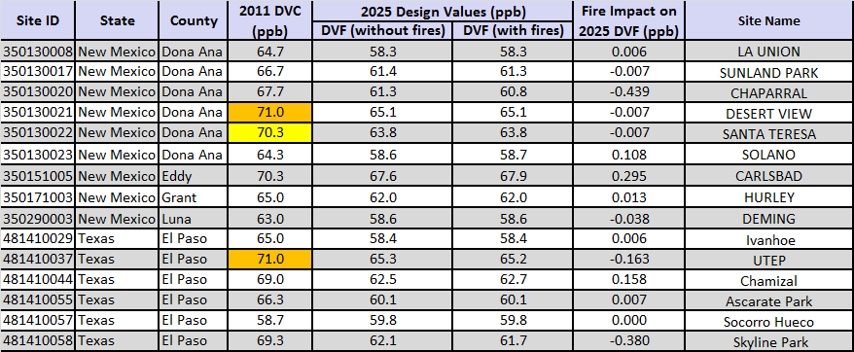
Impact of Fire Emissions on 4 km Grid Monitor DV Results: 2025
Impact of fire emissions on 4 km grid monitor 2025 DVFs is small (< |0.5| ppb)
Used MATS Unmonitored Area Analysis (UAA) to view results across modeling domain

Slide 33
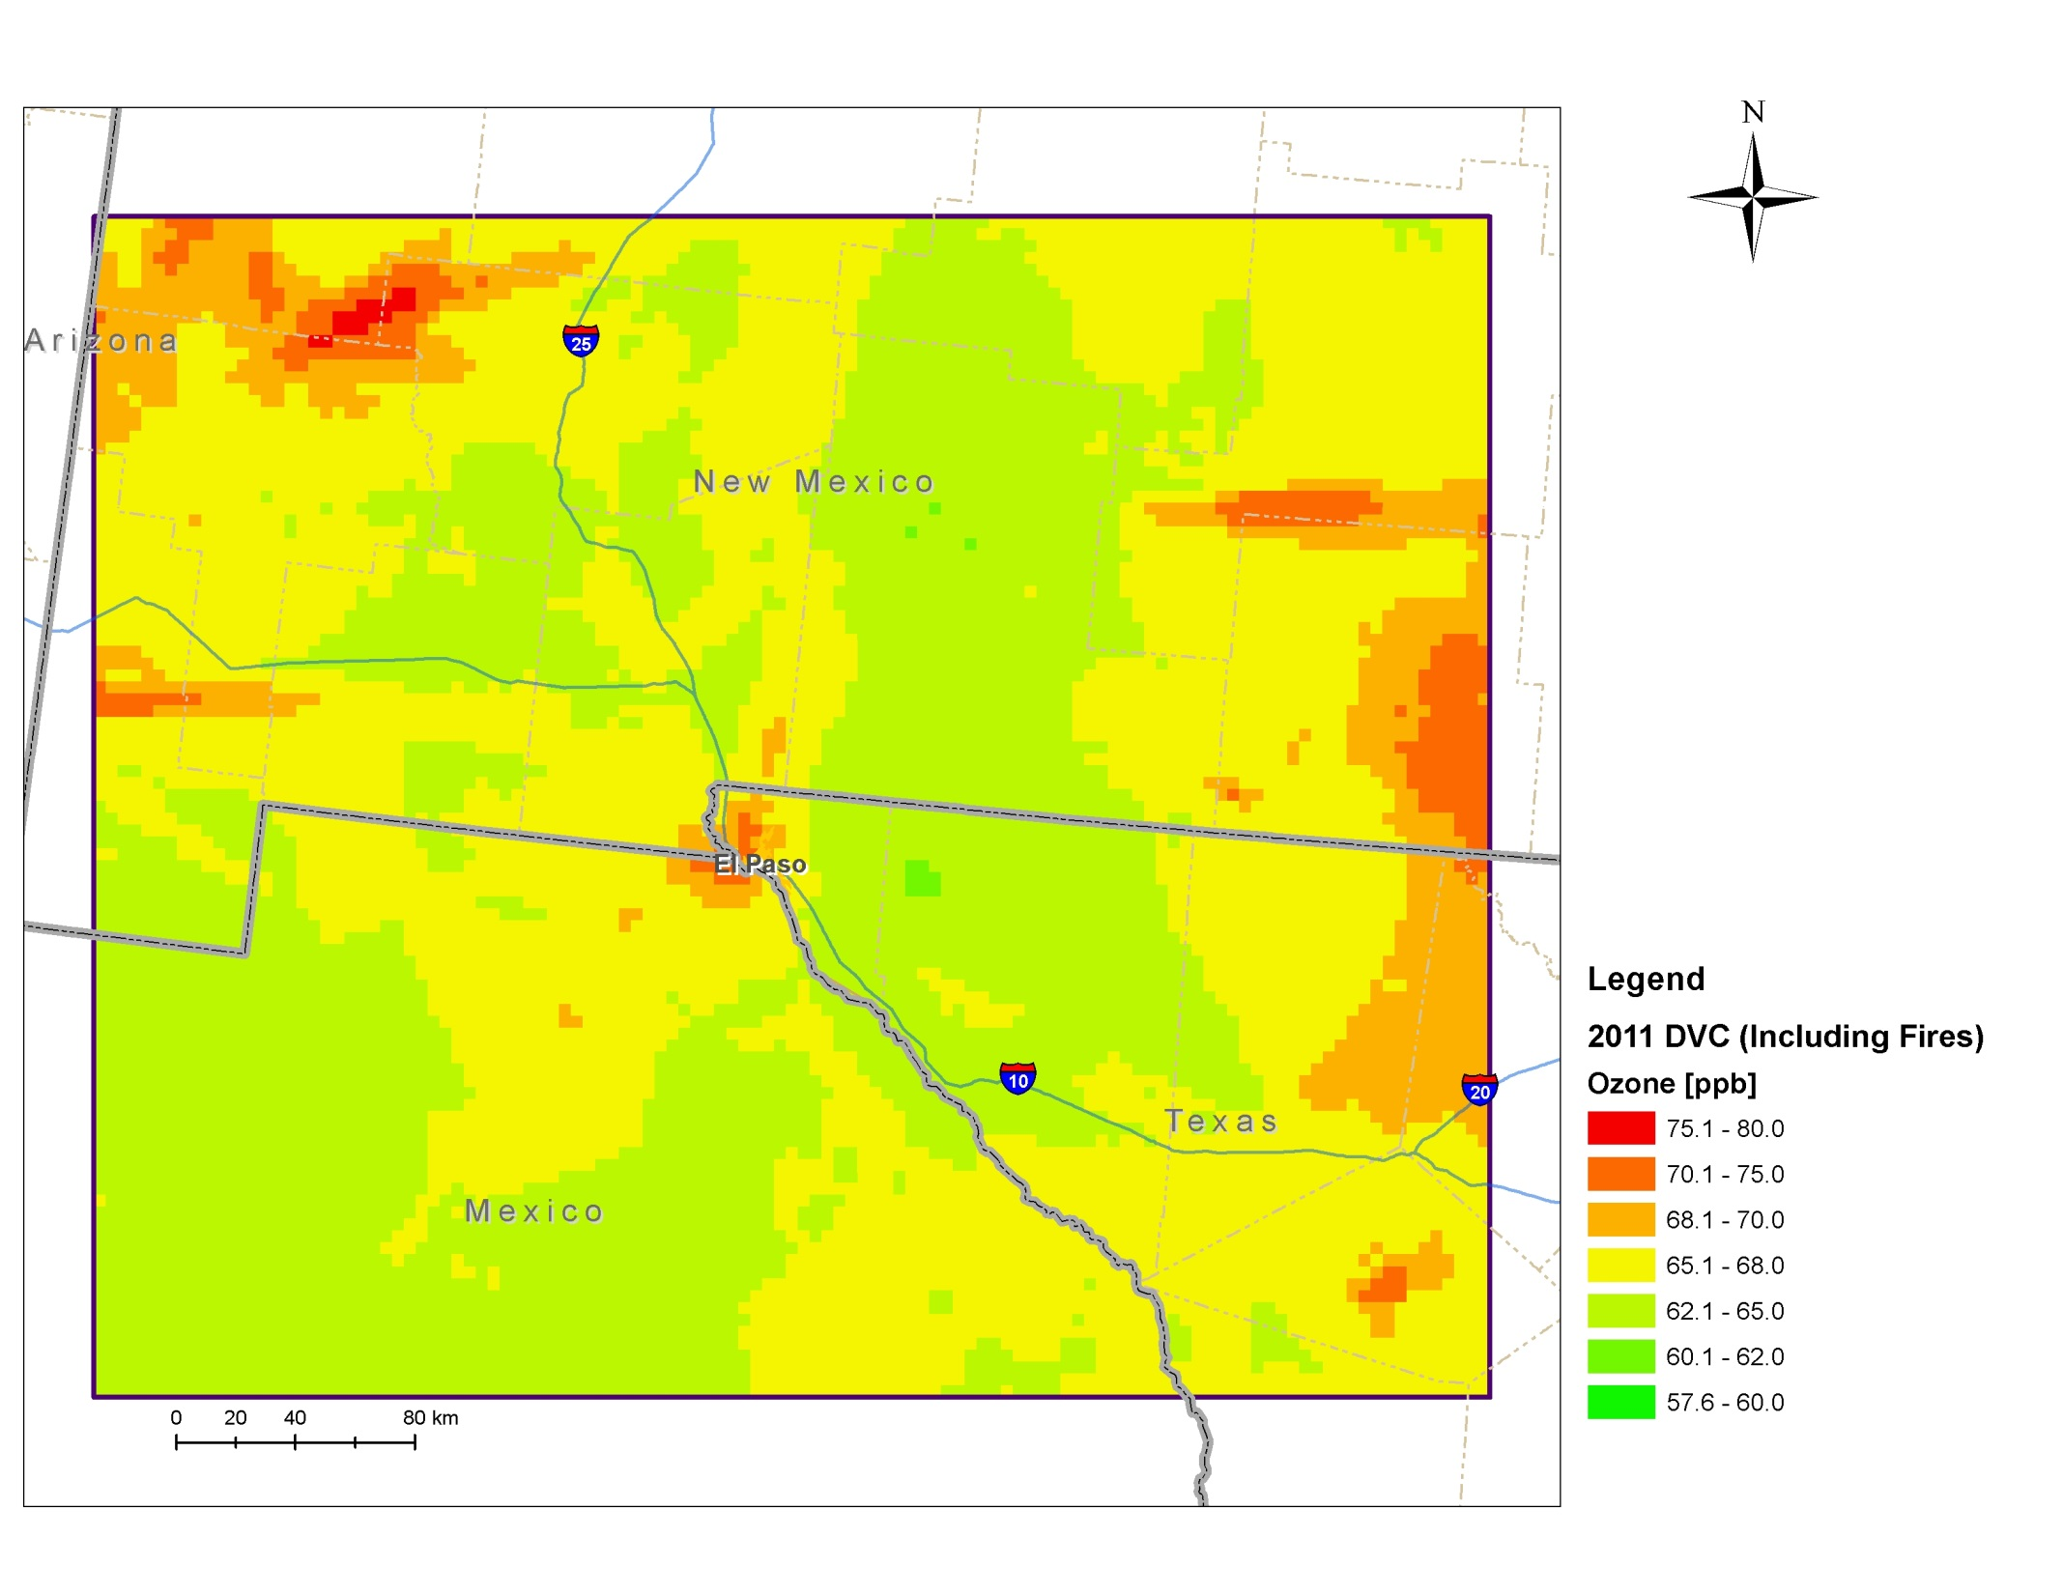
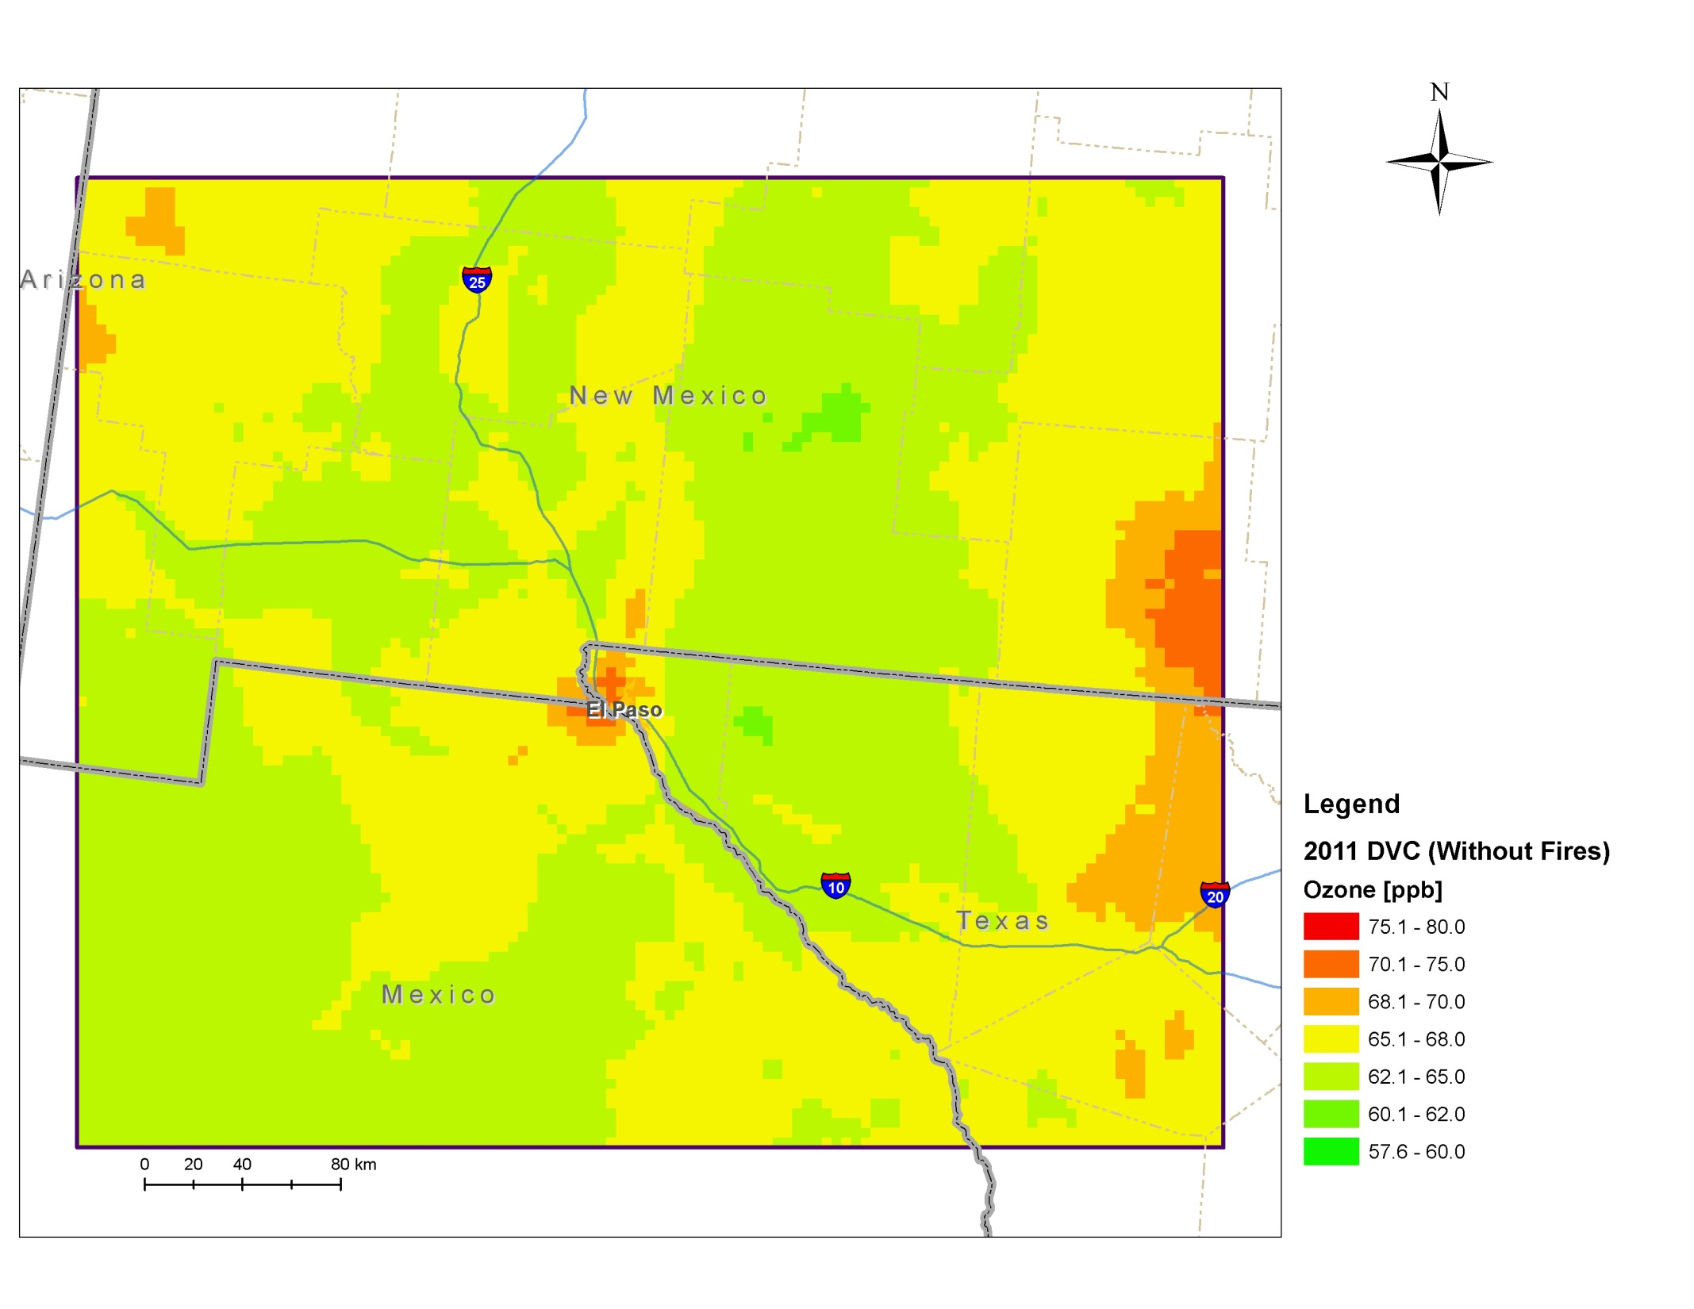
Impact of Fire Emissions on DV Results: 2011 Unmonitored Area Analysis
2011 DVs With Fires
2011 DVs Without Fires

Slide 34
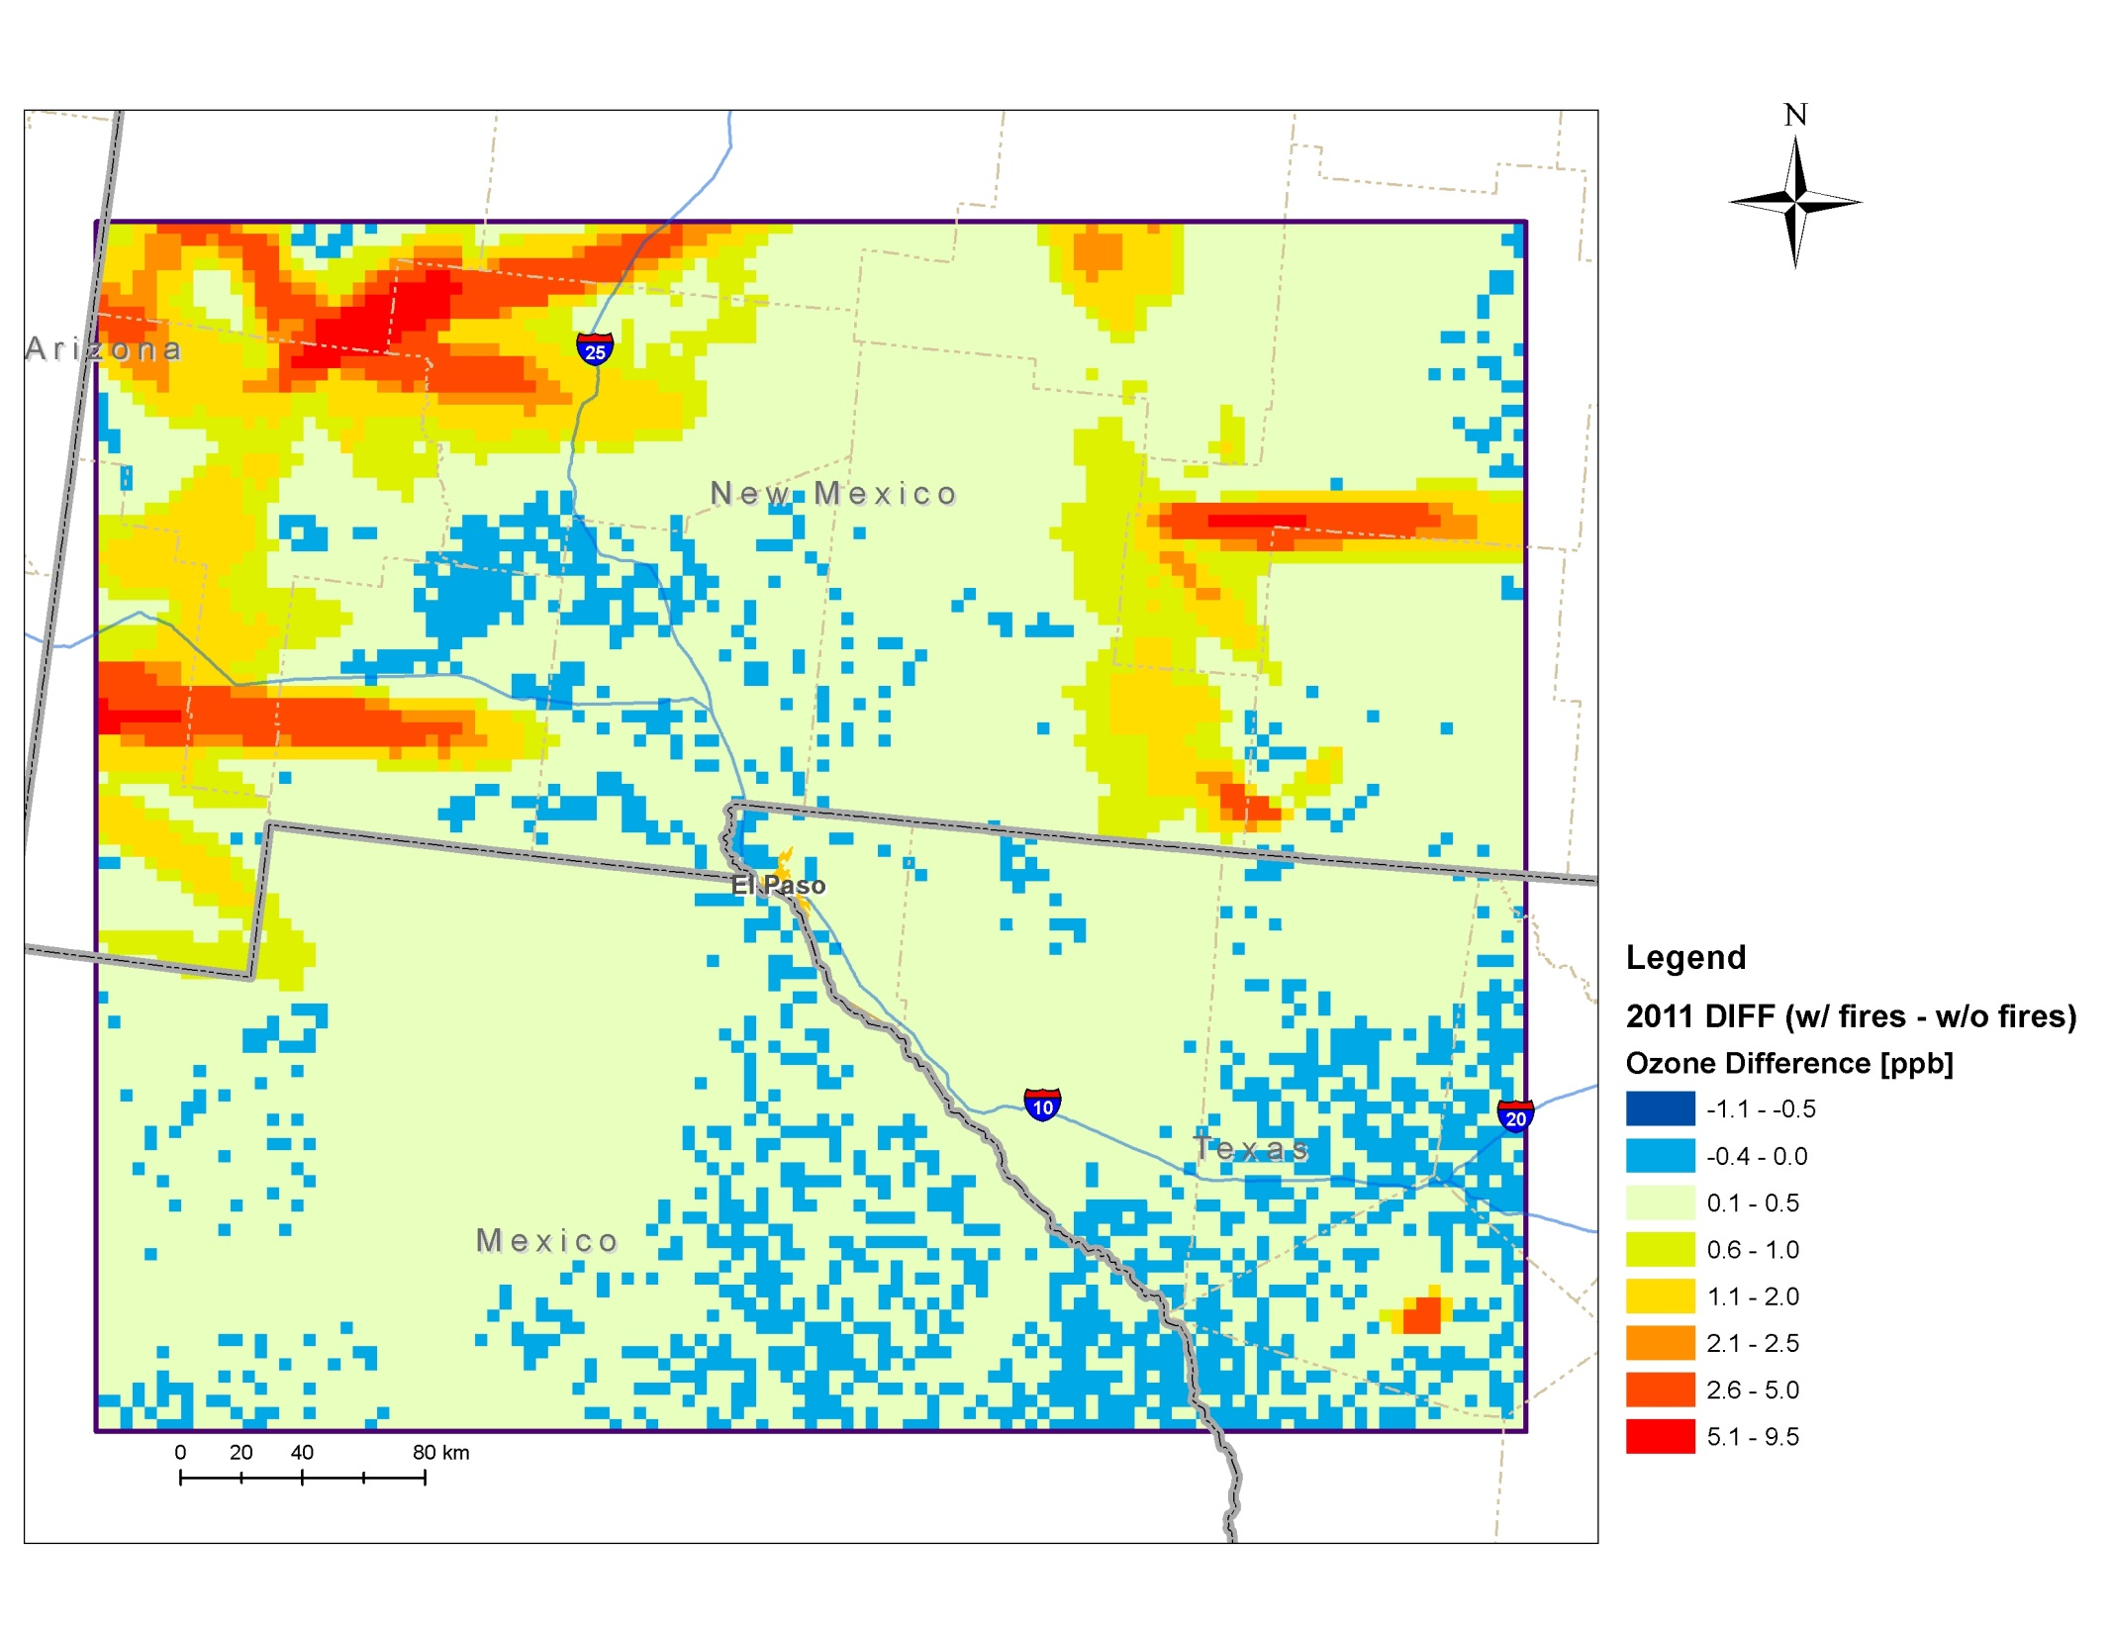
Impact of Fire Emissions on DV Results: 2011 Unmonitored Area Analysis
Impact of fire emissions is ≤ |0.5| ppb at Doña Ana County monitors
Does not affect 2011 DV results
Larger fire impacts on DVs (> 5 ppb) occur elsewhere in 4 km domain downwind of 2011 fires

Slide 35
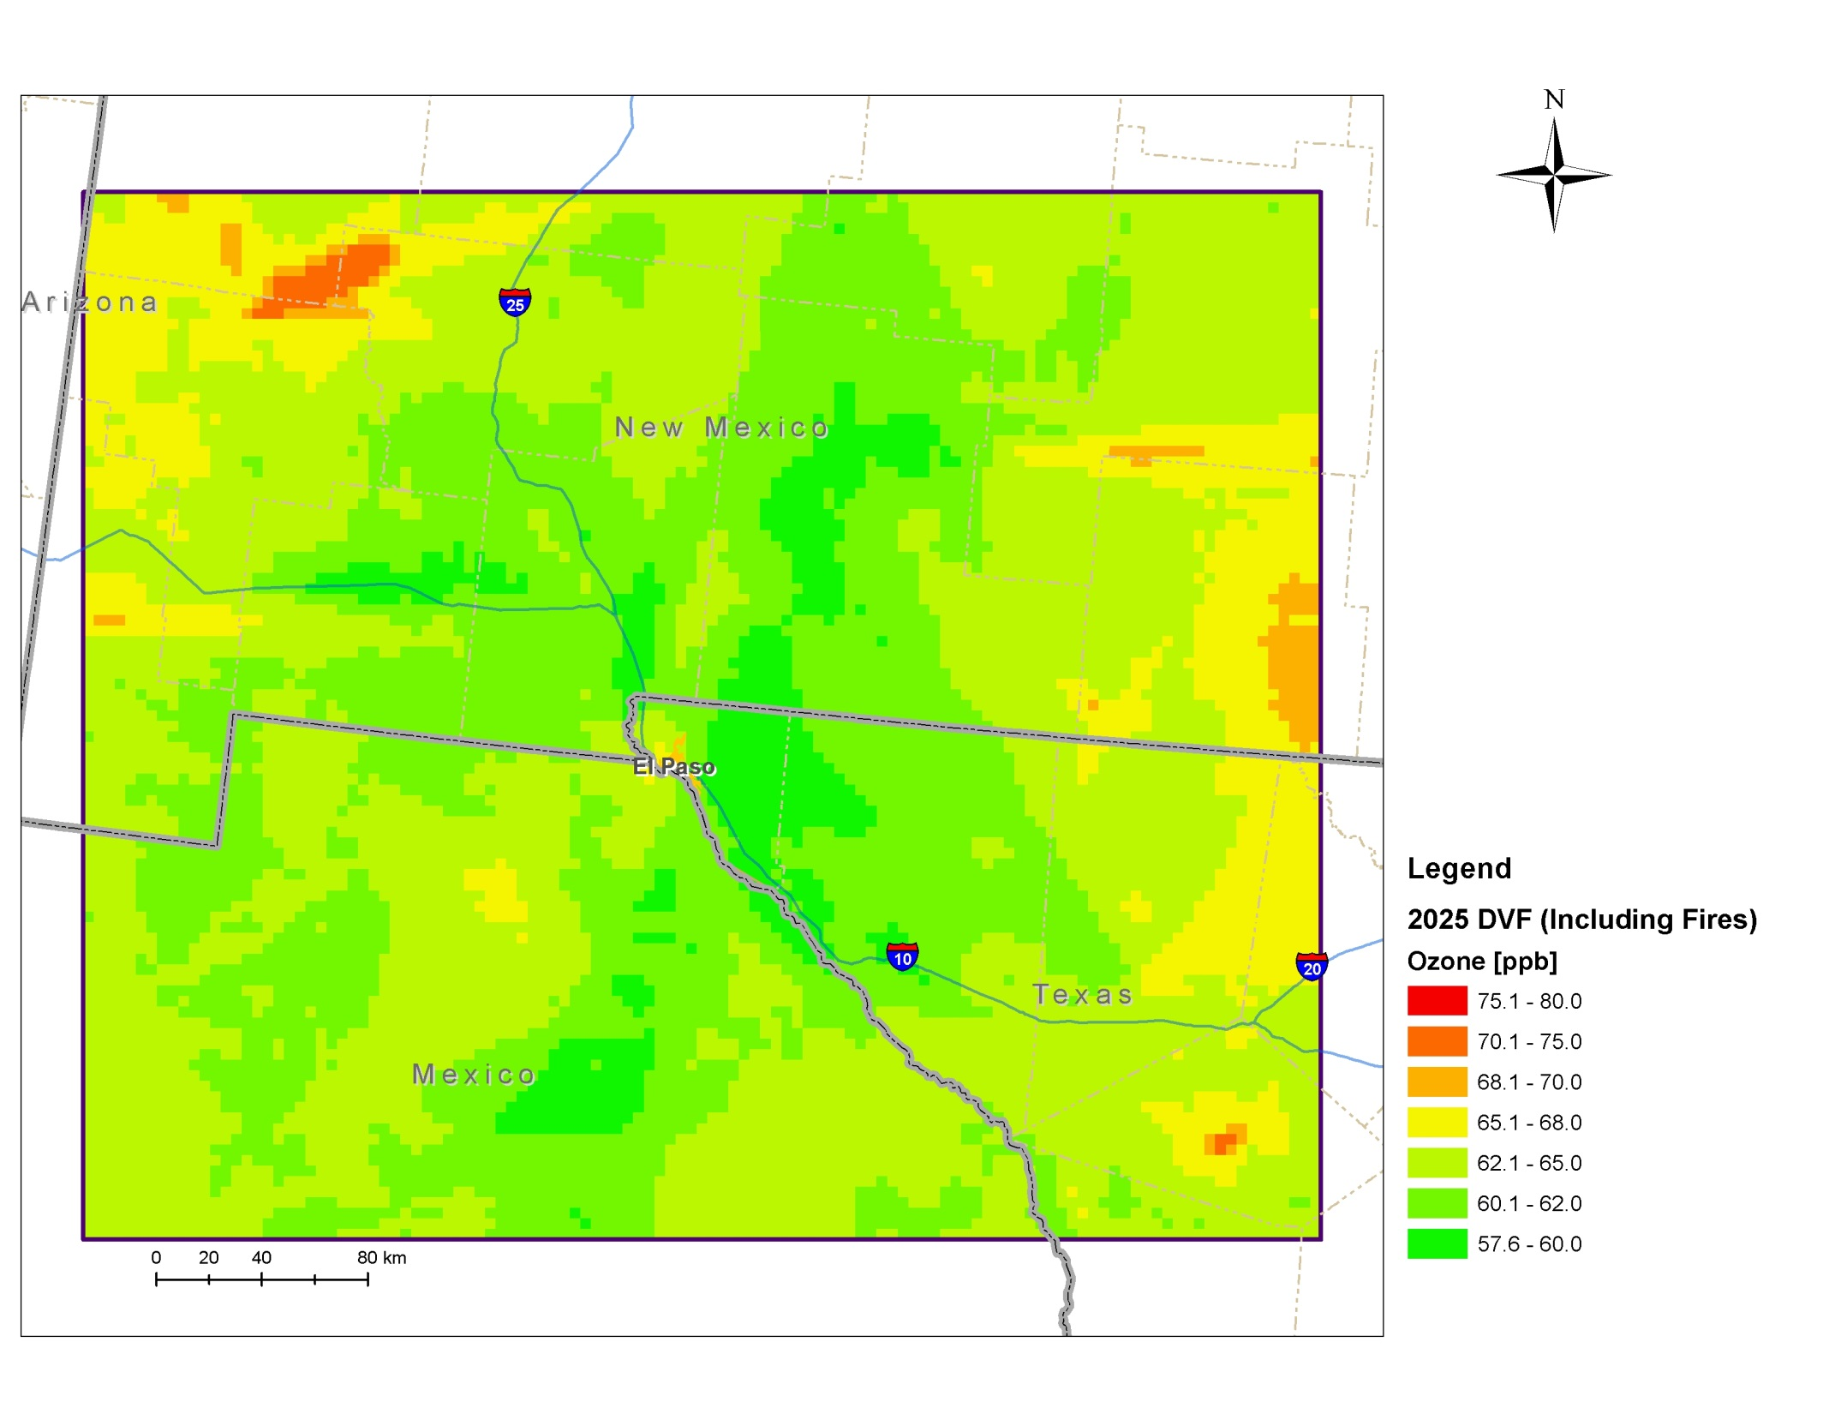
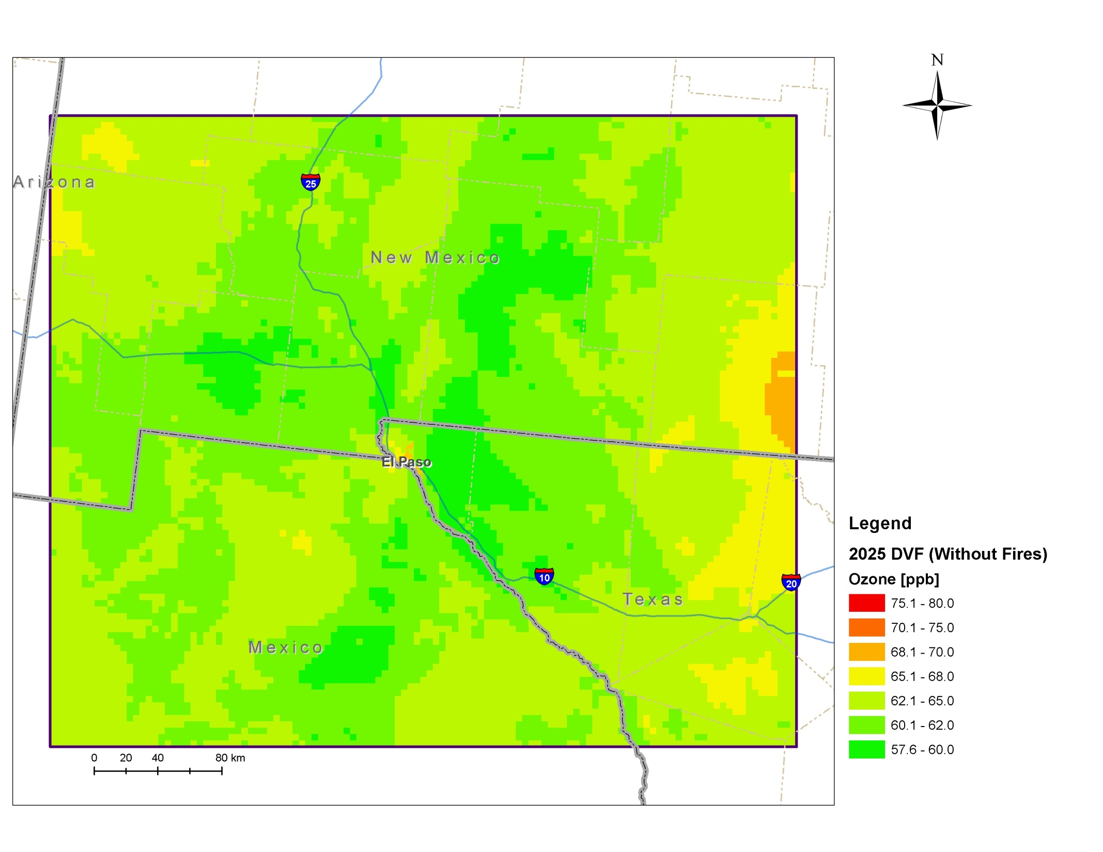
Impact of Fire Emissions on DV Results: 2025 Unmonitored Area Analysis
2025 DVs With Fires
2025 DVs Without Fires

Slide 36
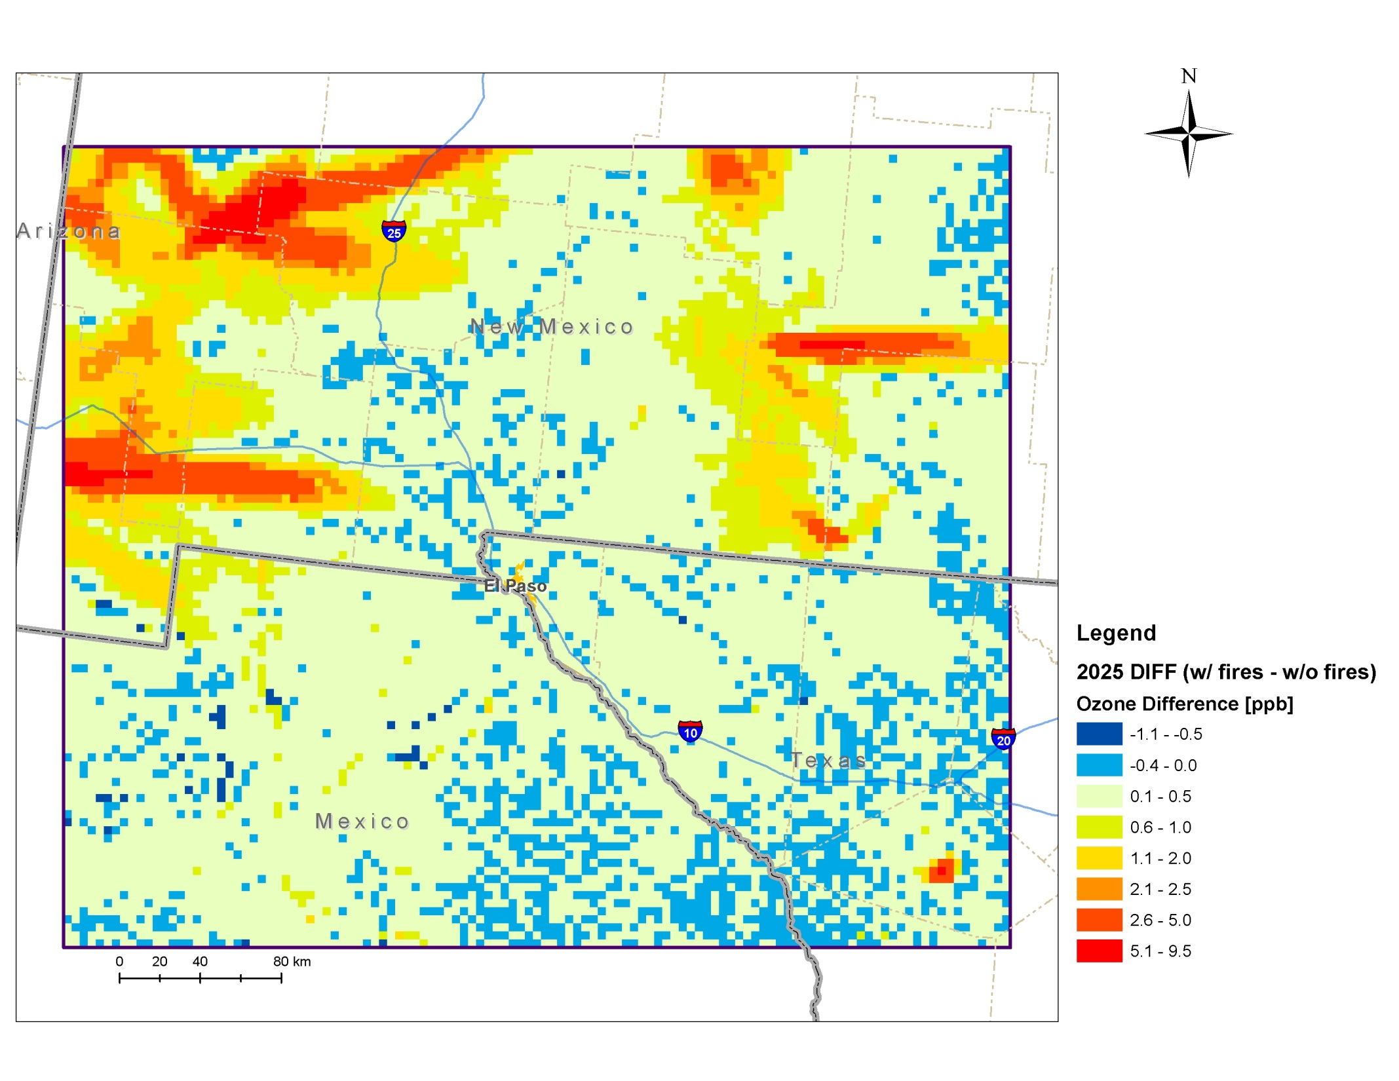
Impact of Fire Emissions on DV Results: 2025 Unmonitored Area Analysis
Impact of fire emissions is ≤ |0.5| ppb at Doña Ana County monitors
Does not affect 2025 DVF results
Larger fire impacts on DVs (> 5 ppb) occur elsewhere in 4 km domain downwind of 2011 fires

Slide 37
Contribution of Fire Emissions to Doña Ana County Ozone: Summary
Fire emissions affected 2011 and 2025 DVs at grid cells within the 4 km domain
UAA shows DV impacts > 5 ppb downwind of the fire locations
Fire emissions had a small (≤ |0.5| ppb) effect on 2011 and 2025 DVs at Doña Ana County monitors
Impacts too small to affect attainment status results for 2011 and 2025
Small impacts due to location of monitors relative to 2011 fires

Slide 38
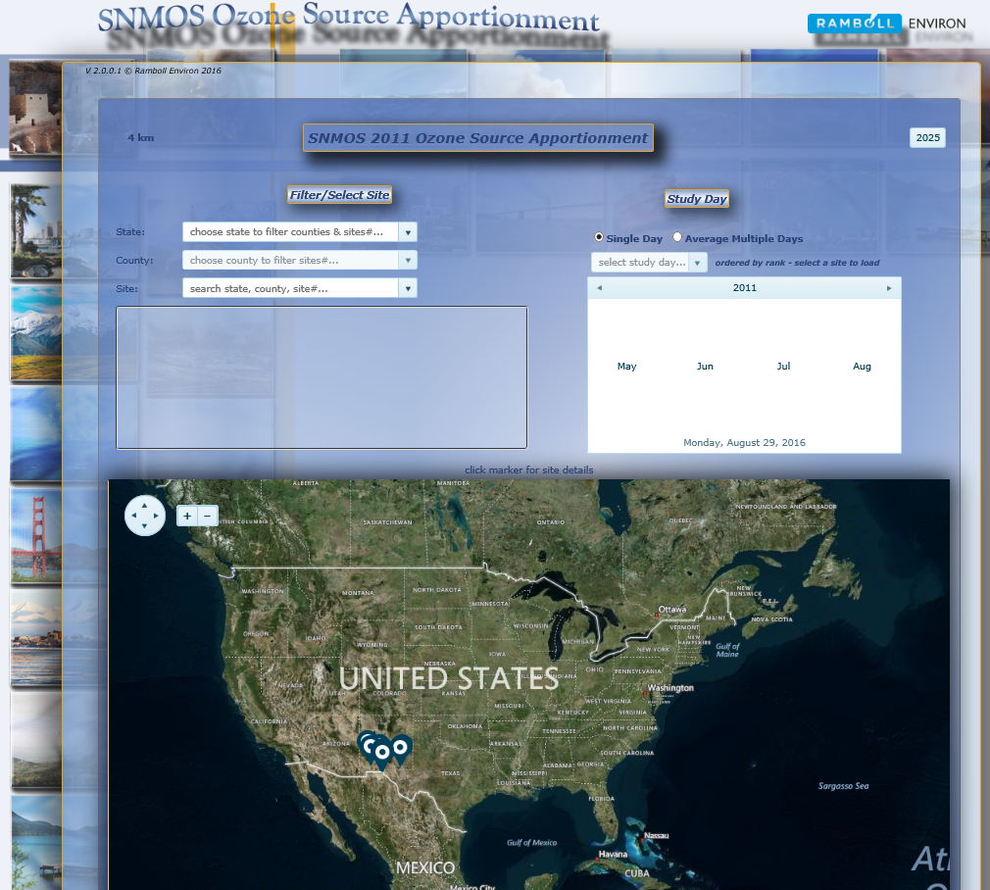
SA Vis Tools Overview
Modeling results loaded into a web-based Source Apportionment Visualization Tool
Displays base (2011) and future (2025) year MDA8 SA results
By monitor, by date
Information on model performance
Documentation in SNMOS wiki on IWDW website

Slide 39
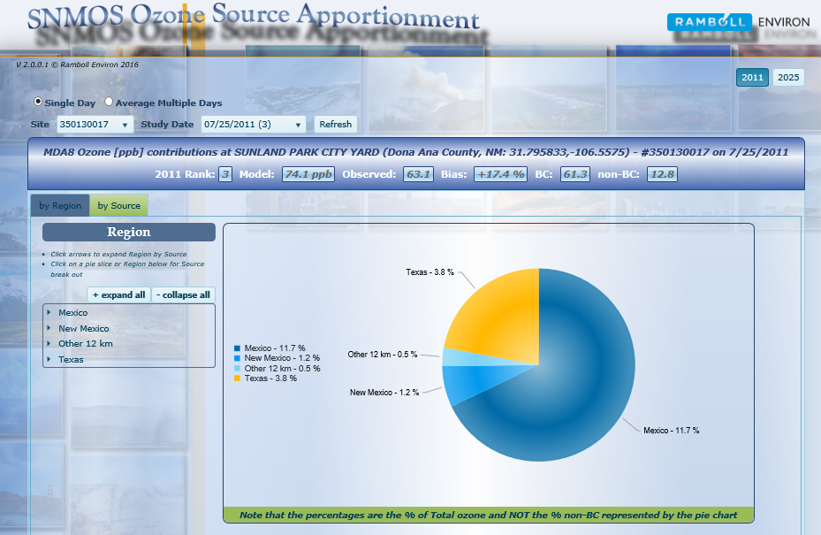
SA Vis Tools: Results by Region
Results for Sunland Park monitor, 2011

Slide 40
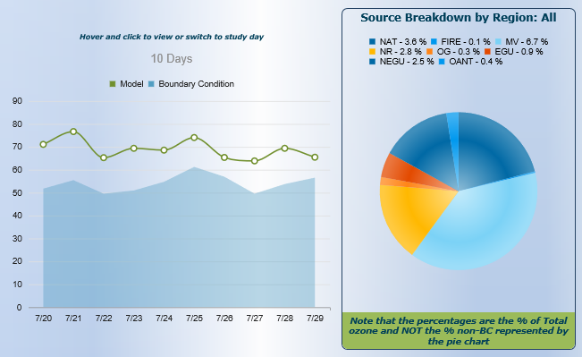
SA Vis Tools: Source Breakdown by Region

Slide 41
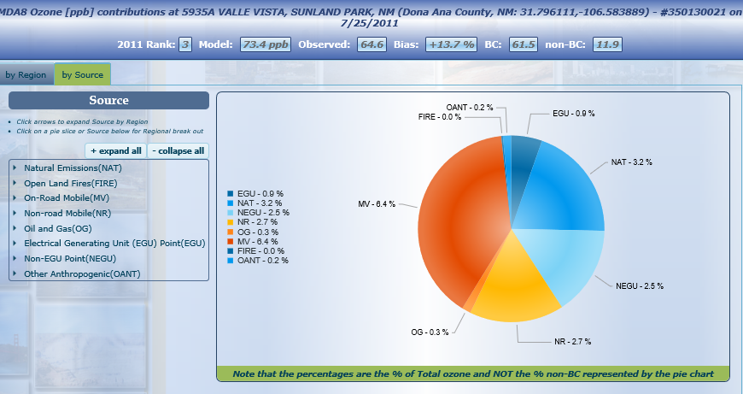
SA Vis Tools: Results by Emissions Sector

Slide 42
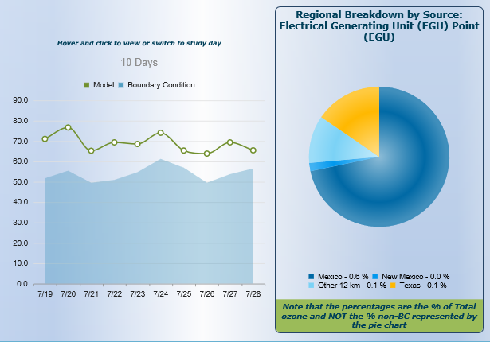
SA Vis Tools: Regional Breakdown by Emissions Source

Slide 43
Access SNMOS Ozone SA Vis Tool wiki through IWDW Website (in development)
http://views.cira.colostate.edu/tsdw/

Slide 44
Task 12 Summary
Transported ozone contributes far more to Doña Ana monitor DVs than New Mexico emissions in 2011 and 2025
Boundary conditions are the largest contributor, then Mexico and Texas
Mexico contribution to Doña Ana monitor 2011 DVs ranges from 2.5 – 6.3 ppb with average of 4.9 ppb
OSAT results indicate but for the contribution of anthropogenic emissions from Mexico, the Desert View monitor would have attained the 70 ppb NAAQS in 2011
In 2011 and 2025, emissions source categories contributing most to Doña Ana monitor DVs were onroad mobile (TX, NM, MEX), natural emissions (MEX) and EGUs (MEX)
Onroad mobile contribution is much (~50%) lower in 2025
Of all New Mexico anthropogenic emissions sources, onroad mobile emissions make largest contribution to DVs at all Doña Ana monitors
Decreases in 2025
Nonroad and O&G make next largest contributions, followed by EGU points
Impact of fire emissions on Doña Ana DV analysis is small

Slide 45
Task 13: Air Quality Technical Support Document
Prepare Air Quality Technical Support Document (TSD)
TSD will summarize methods and finding of all tasks of the SNMOS
Steps
Prepare draft TSD documenting Tasks 1-12
Submit draft TSD for review
Update draft TSD to reflect comments received and prepare a Response to Comments (RtC) document.
Submit final TSD

Slide 46
Air Quality Technical Support Document Outline
Executive Summary
Introduction
SNMOS Task Summaries
Task 1-13
Task Summary
Significant Findings
Milestones and Deliverables
References

Slide 47
Task 13: Air Quality Technical Support Document
Current (September 8, 2016) Status:
All project technical work has been completed
Currently writing technical support document:
Outline completed
Deliverables:
Sep 30 Draft Technical Support Document (TSD)
Oct 14 Comments from NMED
Oct 28 Final TSD
Response to Comments (RtC) document for NMED
Modeling data, RtC document, and final TSD also posted on WAQS data warehouse.

Slide 48
Next Steps Tasks to be Completed by November 18, 2016
Task 1: 2011 WRF 36/12/4 km with 4 km focus on Dona Ana/El Paso/Juarez and Work Plan (Completed)
Task 2: 2011 update Permian Basin O&G (Completed)
Task 3: 2011 update of Juarez and nearby Mexico EI, 2020 Mexico emissions update (Completed)
Task 4: SMOKE current 2011 NEI for 4 km domain (2/29/16)
Task 5: Gridded 2011 biogenic, fires, wind-blown dust, lightning emissions for 4 km domain (2/29/16)
Task 6: Develop 2011 4 km CAMx database and perform base case (2/29/16)
Task 7: 2011 MPE and sensitivity modeling for Dona Ana County (4/30/16)
Task 8: SMOKE current FY US EI and FY Mexico emissions update (4/30/16)
Task 9: FY 4 km CAMx simulation (5/31/16)
Task 10: FY ozone projections (MATS) (5/31/16)
Task 11: FY emissions sensitivity/controls (8/11/16)
Task 12: FY 4 km source apportionment run (9/15/16)
Task 13: Air Quality Technical Support Document (10/28/16)

Slide 49
End—Questions?

Slide 50
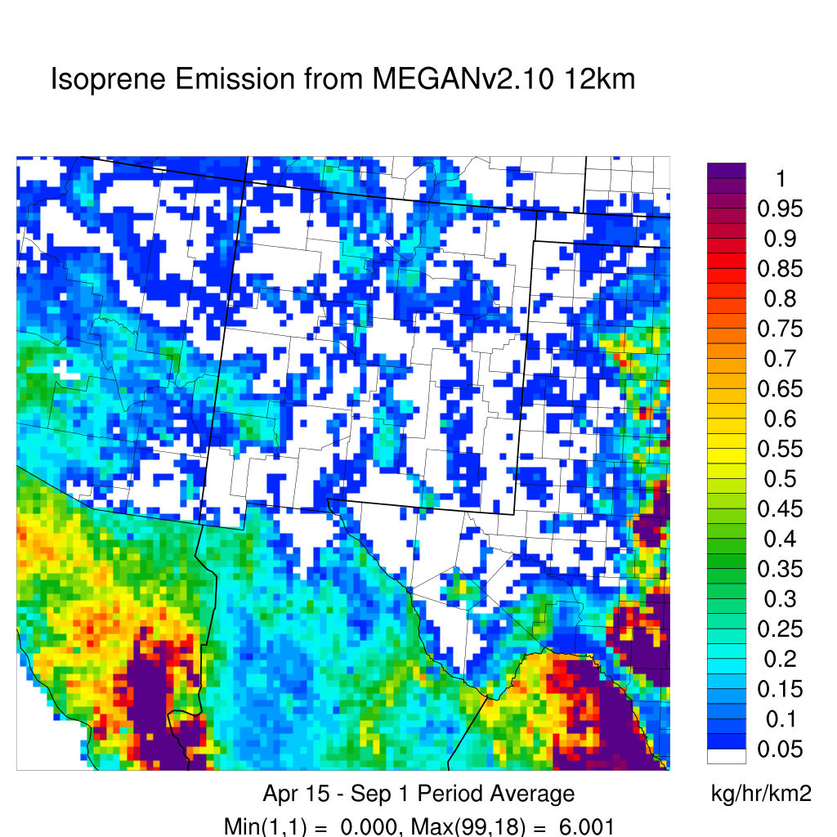
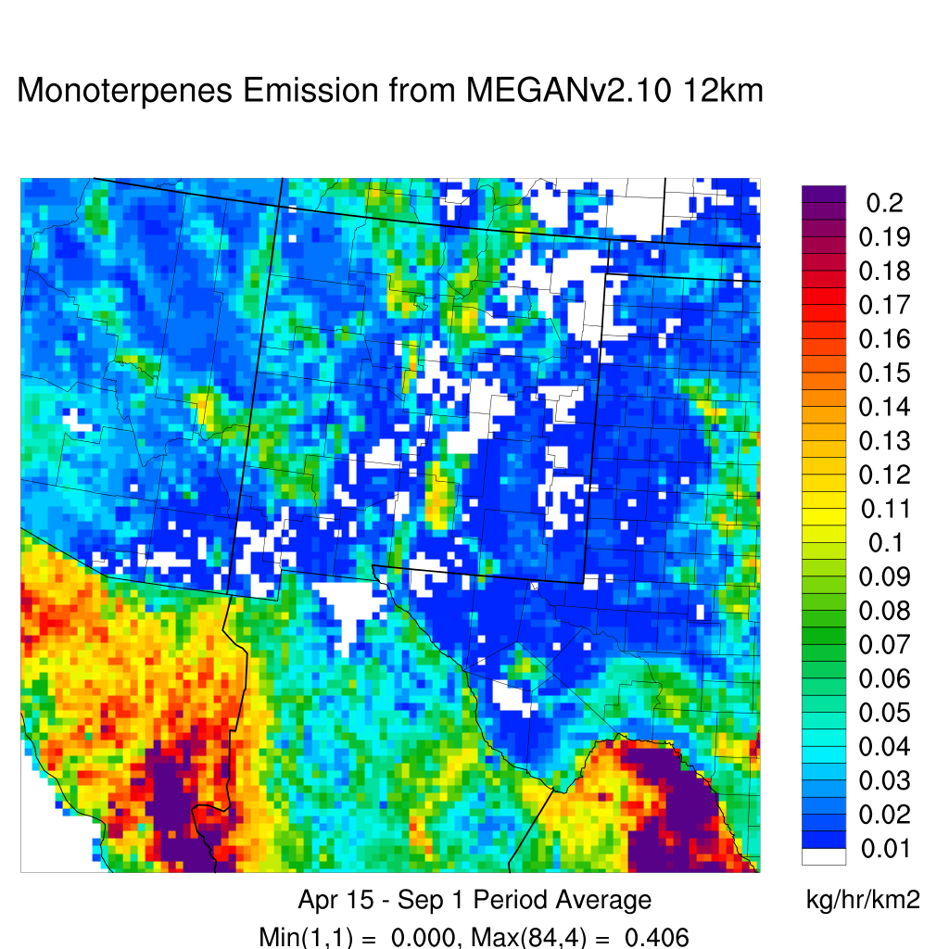
Biogenic Emissions: 12 km Grid
MEGAN v2.10 Episode Average Isoprene
Emissions on 12 km Grid
MEGAN v2.10 Episode Average Monoterpene
Emissions on 12 km Grid

Slide 51
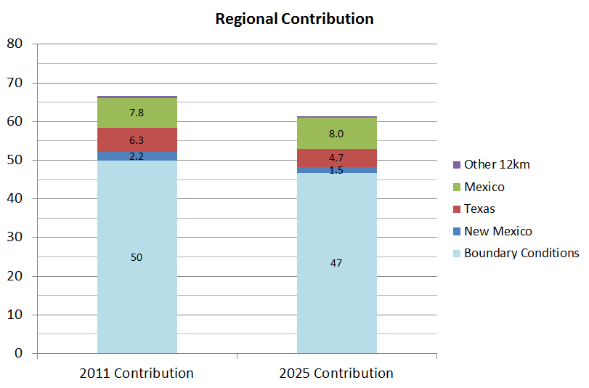
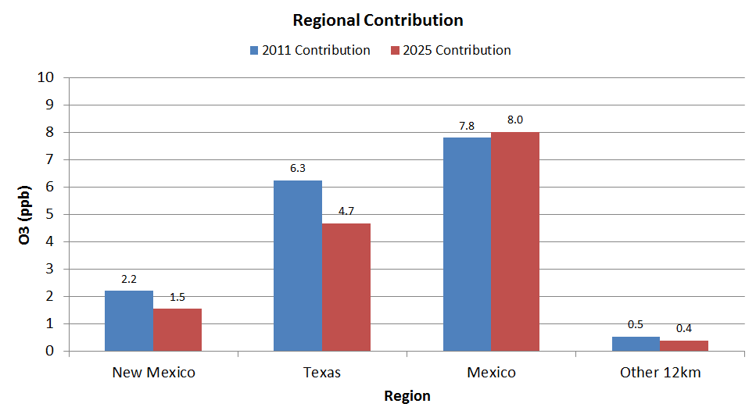
Sunland Park DVC: 66.7 ppb DVF: 61.3 ppb
Reduction in DV driven by reductions in BCs and contributions from Texas and New Mexico
Contribution from Other 12 km declines
Slight decrease in Mexico contribution

Slide 52
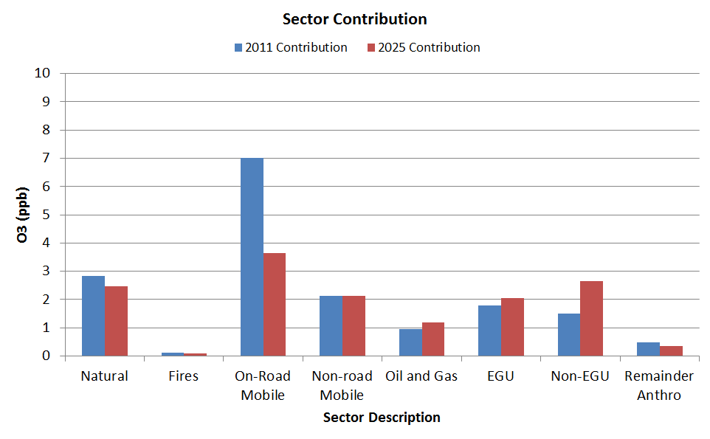
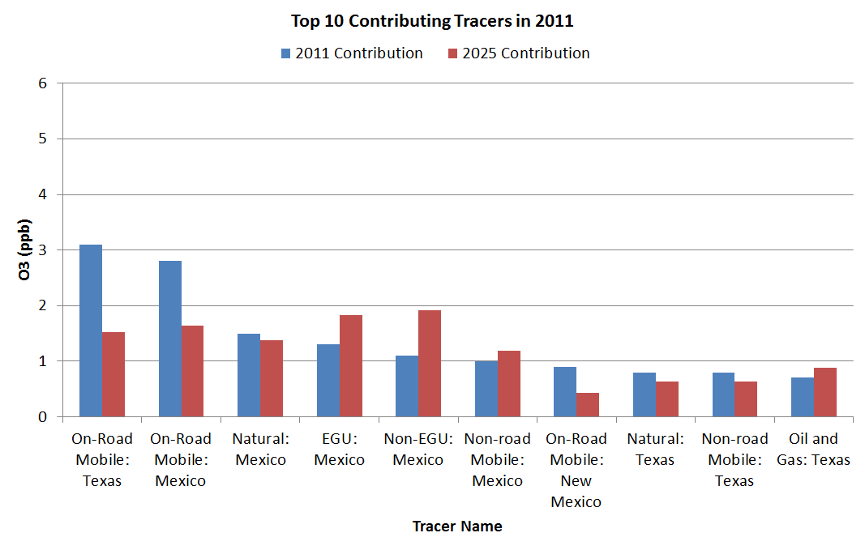
Sunland Park DVC: 66.7 ppb DVF: 61.3 ppb
Largest 2011 contributions from Texas and Mexico on-road emissions
Increase in Mexico EGU contribution in 2025

Slide 53
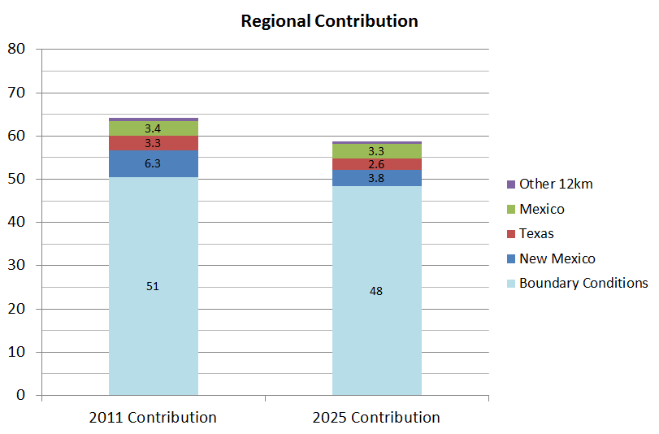
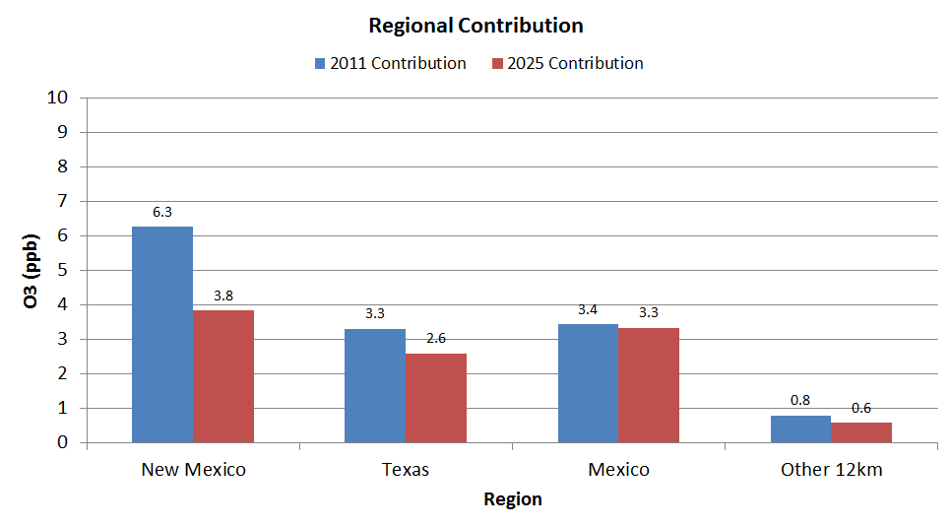
Solano DVC: 64.3 ppb DVF: 58.7 ppb
Reduction in DV driven by reductions in BCs and contributions from Texas and New Mexico
Contribution from Other 12 km declines
Slight decrease in Mexico contribution

Slide 54
Solano DVC: 64.3 ppb DVF: 58.7 ppb
Largest 2011 contributions from Texas and Mexico on-road emissions
Increase in Mexico EGU contribution in 2025

Slide 55
La Union DVC: 64.7 ppb DVF: 58.3 ppb
Reduction in DV driven by reductions in BCs and contributions from Texas and New Mexico
Contribution from Other 12 km declines
Slight decrease in Mexico contribution

Slide 56
La Union DVC: 64.7 ppb DVF: 58.3 ppb
Largest 2011 contributions from Texas and Mexico on-road emissions
Increase in Mexico EGU contribution in 2025

Slide 57
Chaparral DVC: 67.7 ppb DVF: 60.8 ppb
Reduction in DV driven by reductions in BCs and contributions from Texas and New Mexico
Contribution from Other 12 km declines
Slight decrease in Mexico contribution

Slide 58
Chaparral DVC: 67.7 ppb DVF: 60.8 ppb
Largest 2011 contributions from Texas and Mexico on-road emissions
Increase in Mexico EGU contribution in 2025

Slide 59
Top 5 Contributors to 4 km Grid Non-Doña Ana New Mexico Monitor DVs
Largest 2011 contributions from Texas and Mexico on-road emissions
Increase in Mexico EGU contribution in 2025
Notes:
Hurley, Carlsbad, Deming

Slide 60
Ozone Contribution Calculations: 2025

Slide 61
Ozone Contribution Calculations: 2011

